Slide 1

Marie Curie
Sunny – Bao Anh – HR 6A2

Slide 2
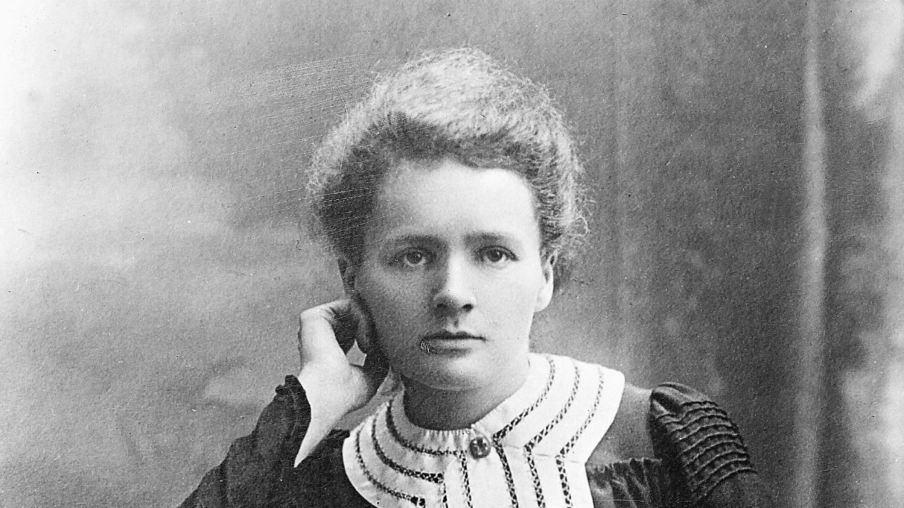
About Marie Curie
Marie Curie (Maria Skłodowska) was born on 7 November, 1867 in Warsaw, Poland. She was the youngest child in her family.
Marie is very smart. She never lost her passion of reading, studying.
She has 2 daughters, Irene and Eve.

Slide 3
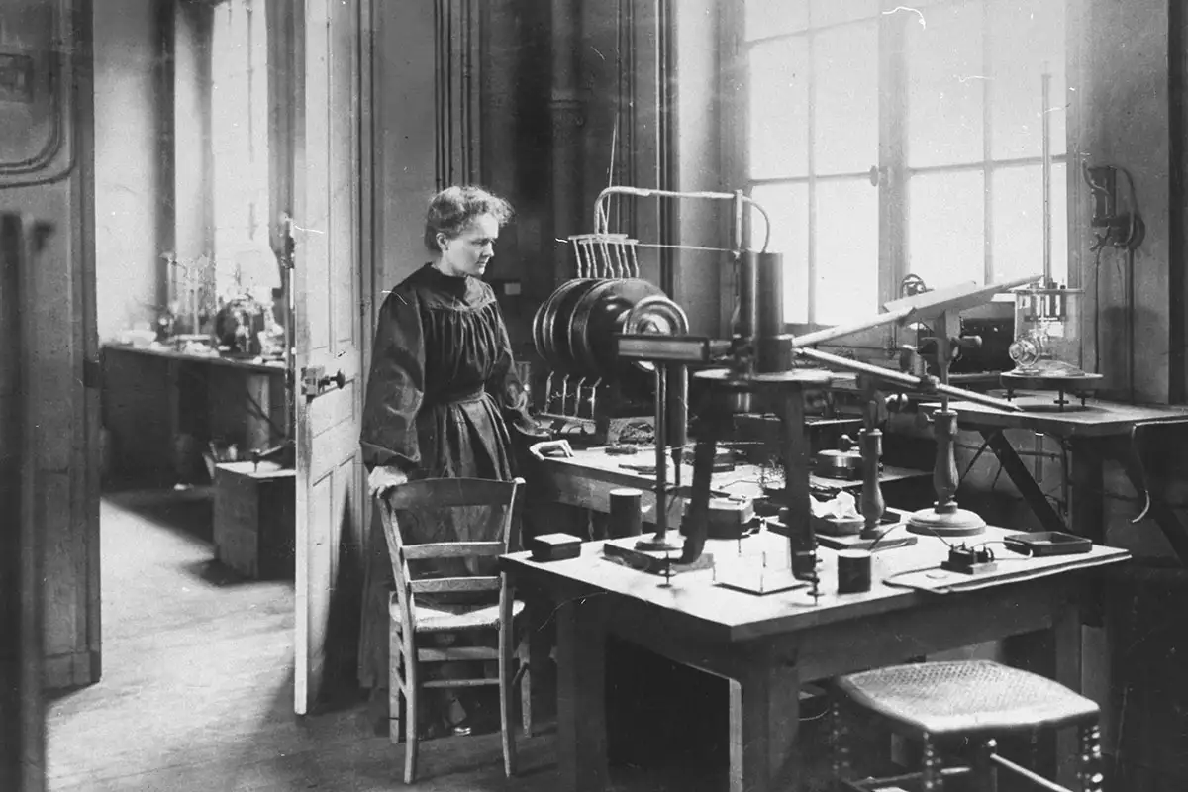
Working on Radioactivity
Marie and her husband discovered Polonium and Radium is July, 1898
She had to work with radiation, which created sickness for her.
Her work laid the groundwork for future models by discovering that radioactivity comes from within the atom itself.

Slide 4
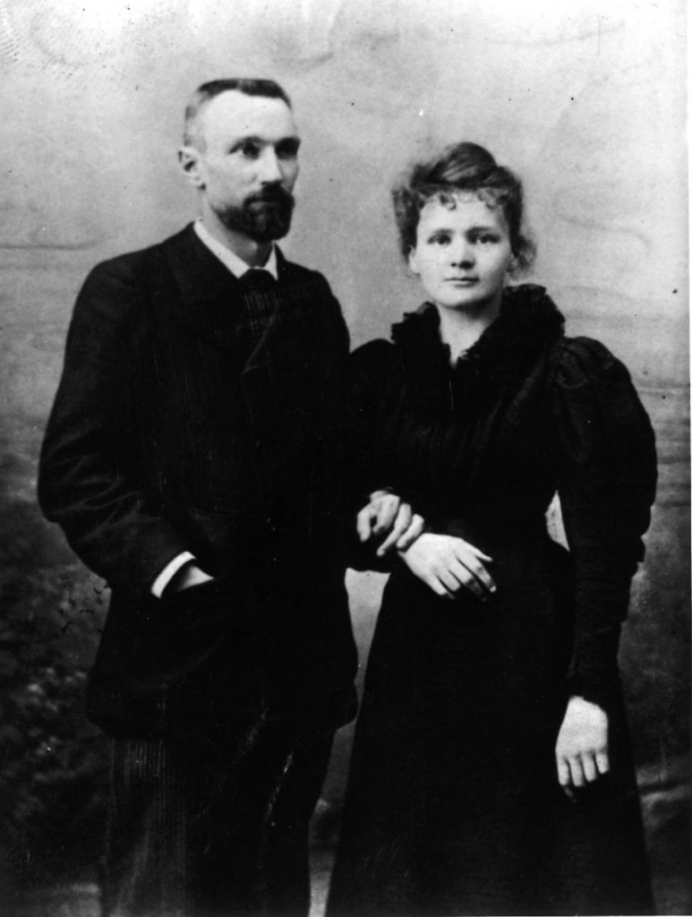
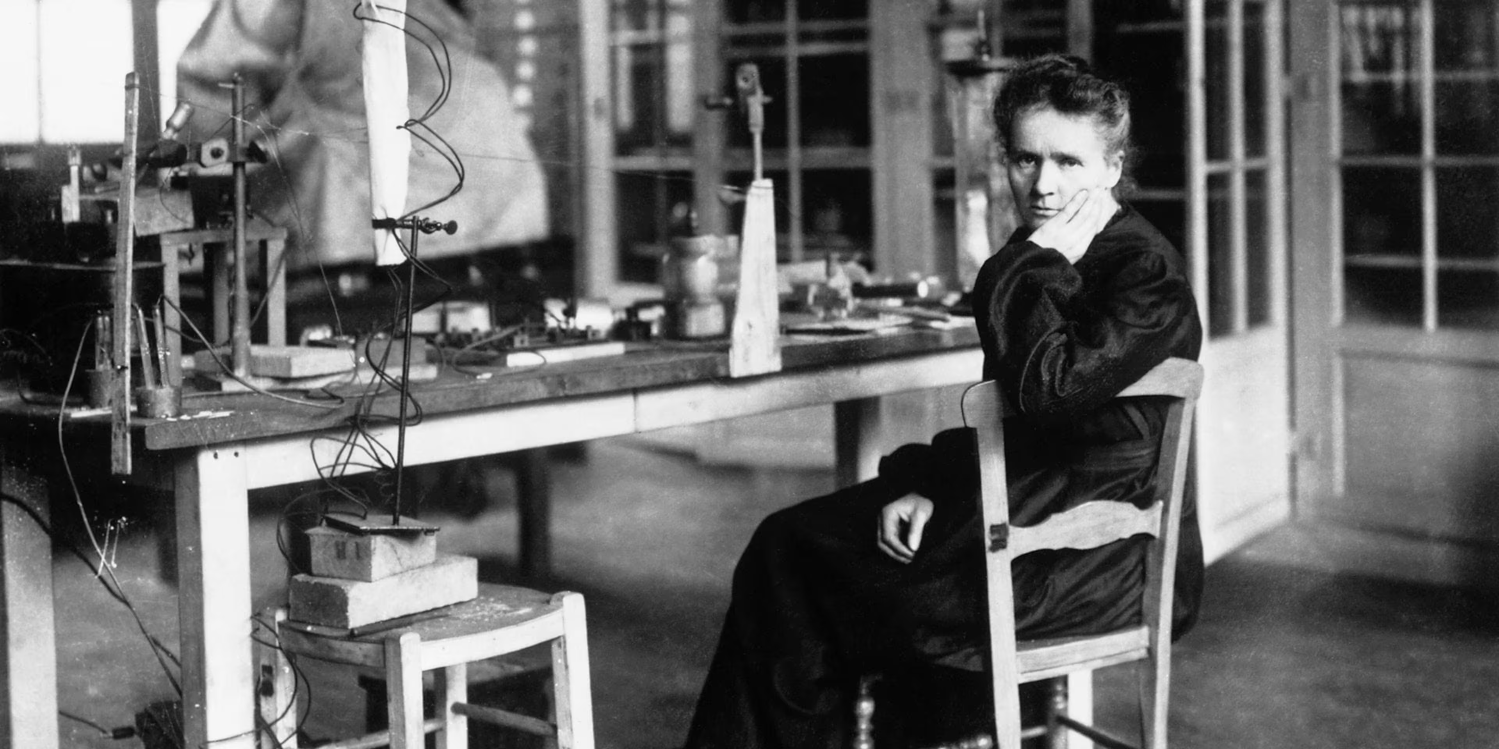
Marie Curie’s Nobel Prizes
In 1903, Marie and her husband was awarded for the Nobel Prizes of Physics.
She awarded the second Nobel Prize in 1911, this time in Chemistry for creating a means of measuring radioactivity.

Slide 5
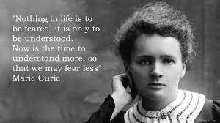

Slide 6
Work cited
Marie Curie – Biographical. NobelPrize.org. Nobel Prize Outreach 2025. Sun. 9 Nov 2025.
https://www.mariecurie.org.uk/who/our-history/marie-curie-the-scientist
https://www.sciencefocus.com/science/marie-curie-facts
Facts and biography | Live Science
The first woman to ever win a Nobel | New Scientist

