Slide 1


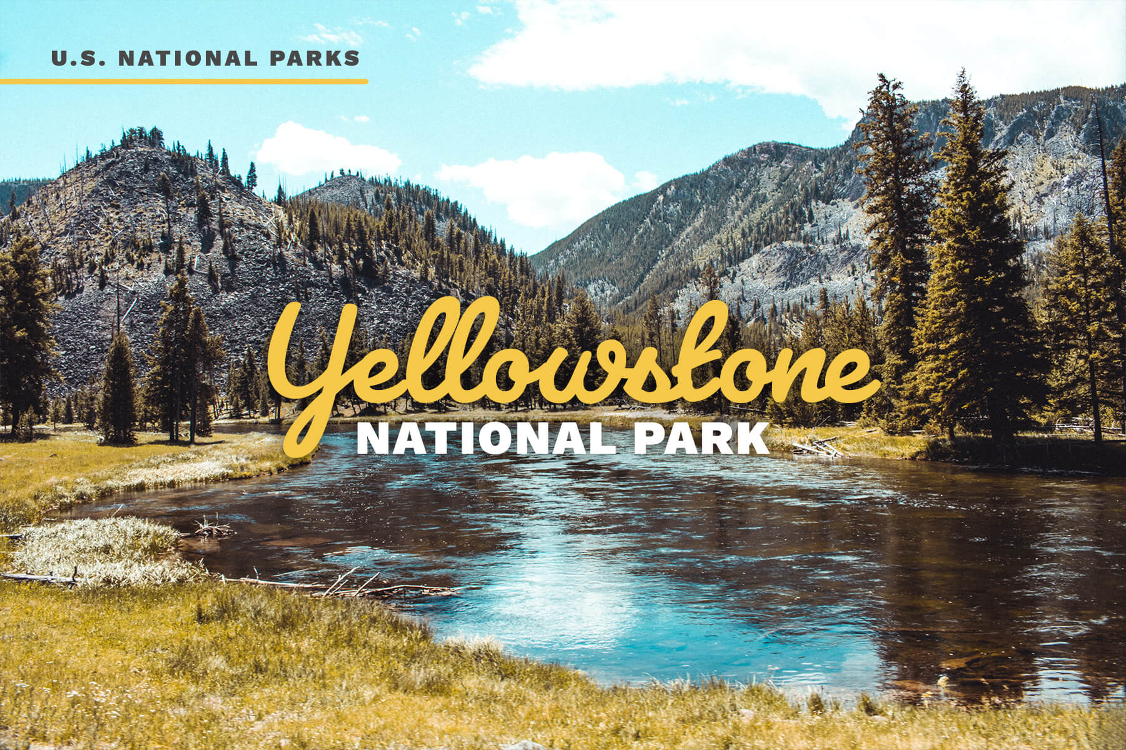
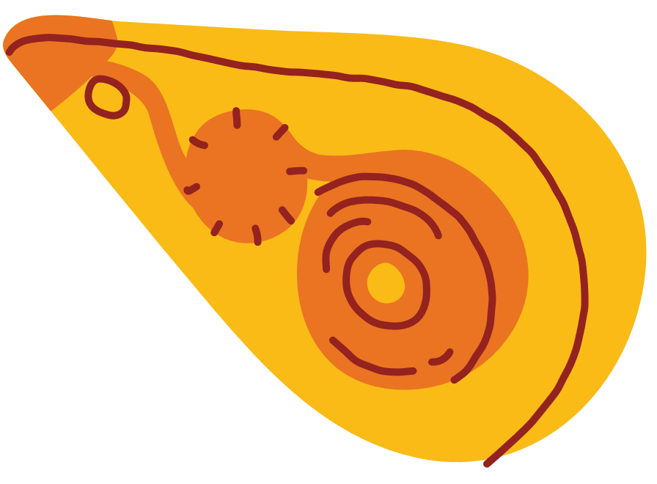



Prepared By Anna

Slide 2




  Introduction
  Geographic Features
  Biological Features
  Problems & Solutions
Table of Contents

Slide 3
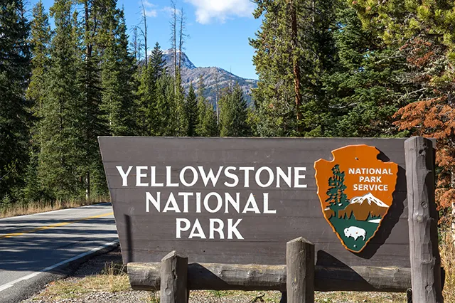
Introduction
  Established on March 1, 1872, Yellowstone National Park is the first national park in the United States and is widely recognized as the first in the world.
  Located in the northwest corner of Wyoming.
  The park covers an impressive 2.2 million acres.
  It is vastly larger than other notable conservation sites, like Cuc Phuong National Park in Vietnam, which covers 55,000 acres.

Slide 4
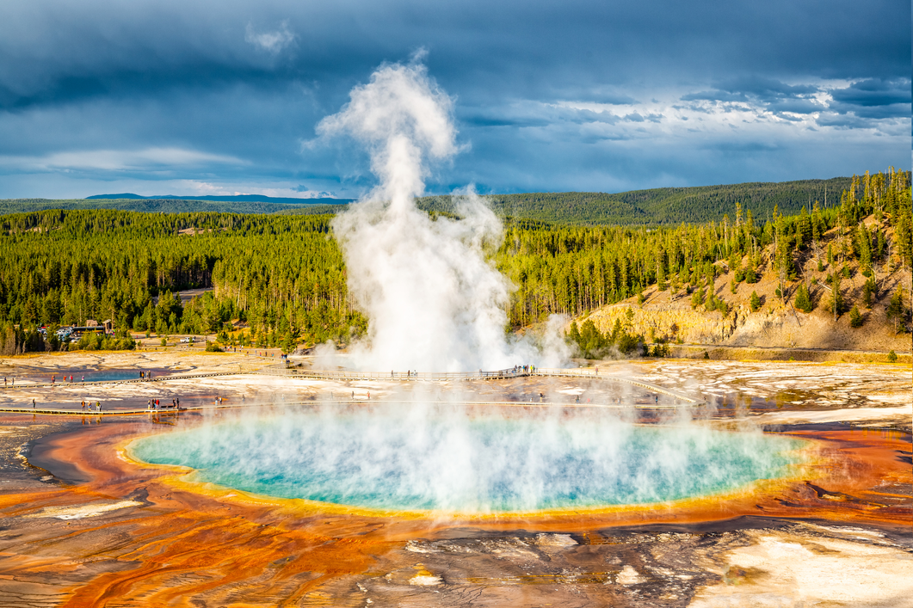
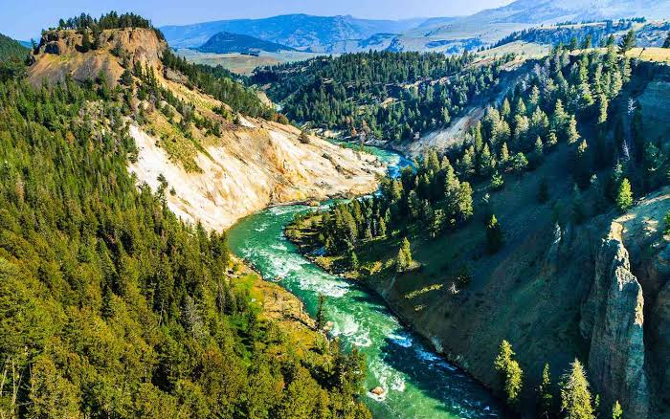
Major Highlights
  Geothermal Wonders: Yellowstone is home to more than 10,000 hydrothermal features, including hot springs, mudpots, and fumaroles.
  The Grand Prismatic Spring: This is the largest hot spring in the United States. It is famous for its striking, rainbow - colored rings which are actually caused by heat-loving bacteria.
  The "Serengeti of North America": Yellowstone is one of the best places in the U.S. to see free-roaming wildlife in their natural habitat. Visitors can spot bison, grizzly bears, gray wolves, elk, and moose.
  Dramatic Landscapes:
    Grand Canyon of the Yellowstone: A breathtaking canyon carved by the Yellowstone River featuring plunging waterfalls.
    Yellowstone Lake: One of the largest high-elevation lakes in all of North America.

Slide 5

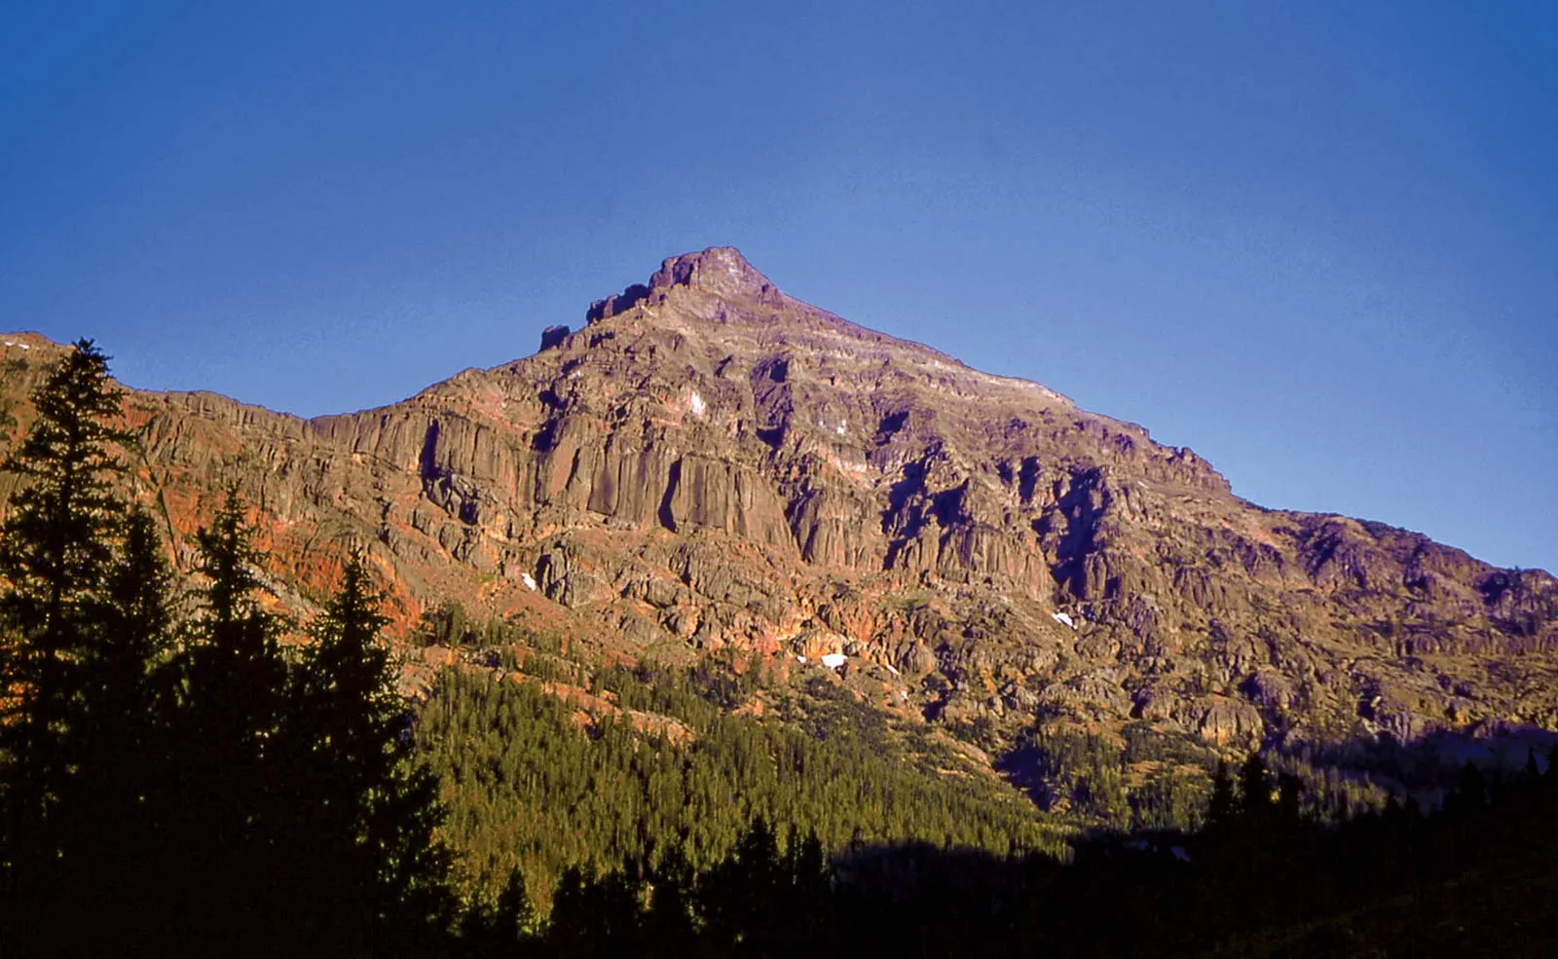
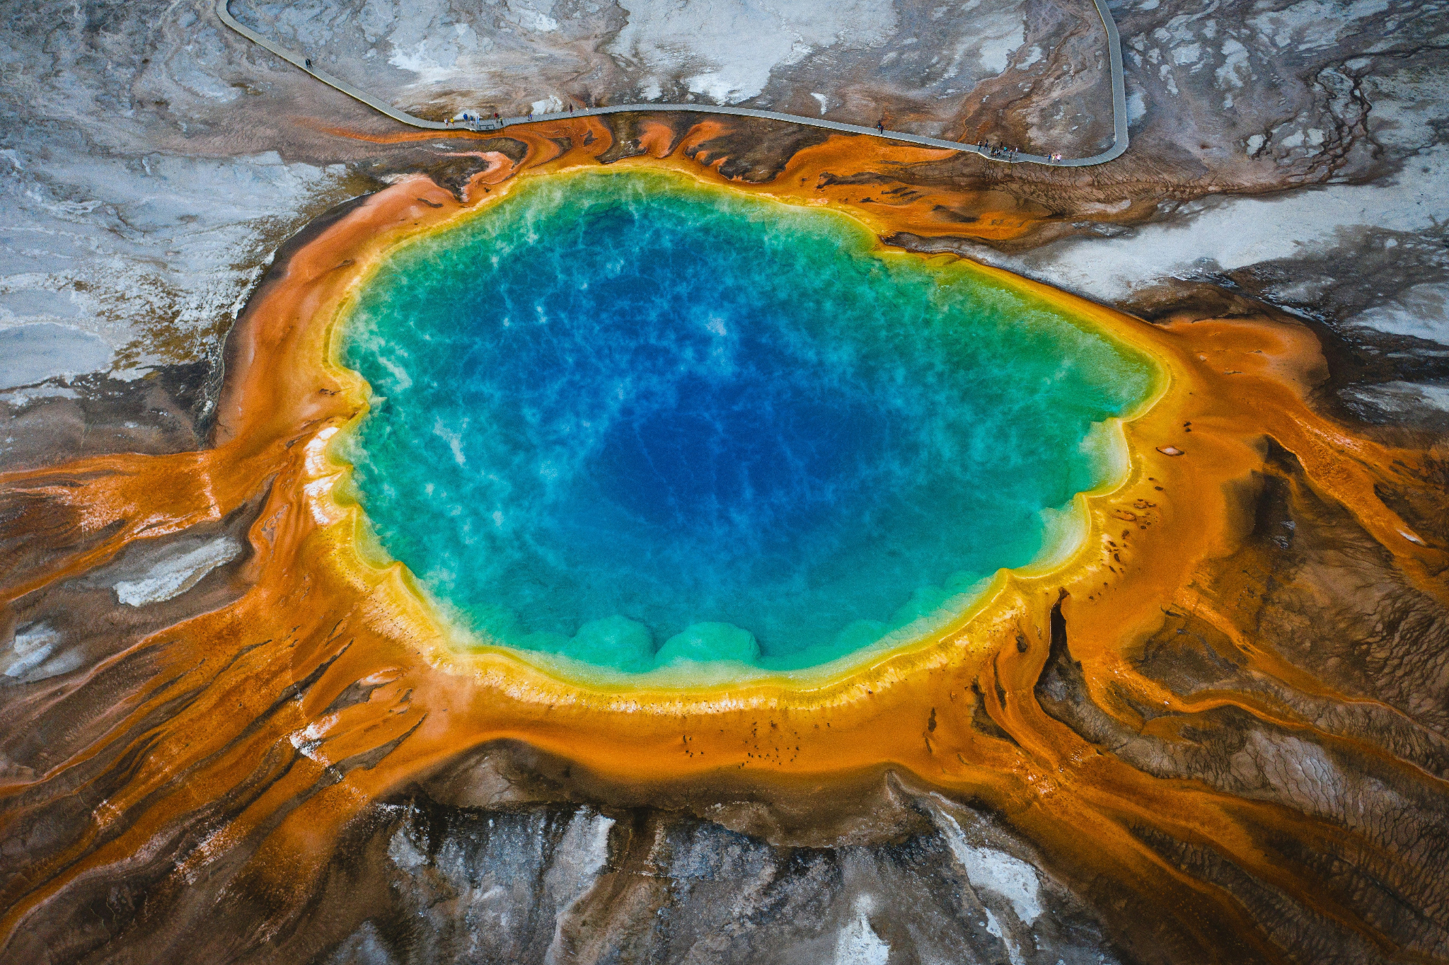
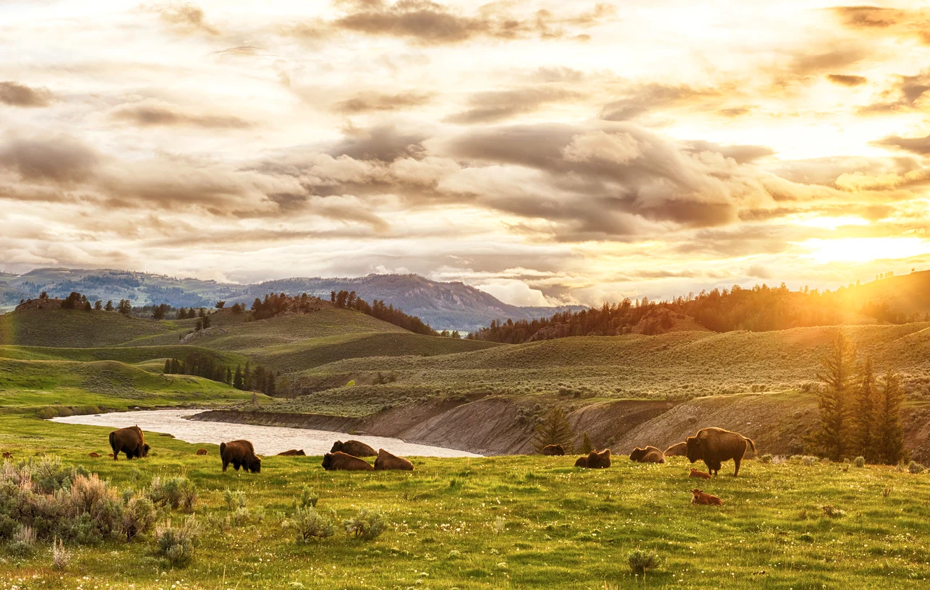
Geographic Features

Slide 6
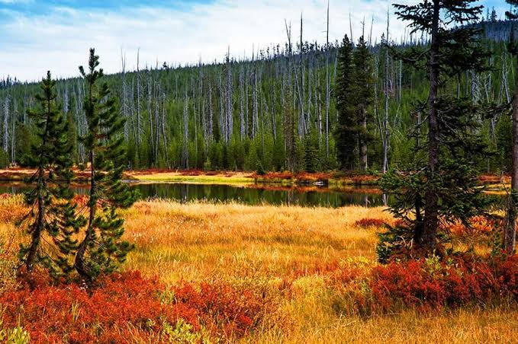
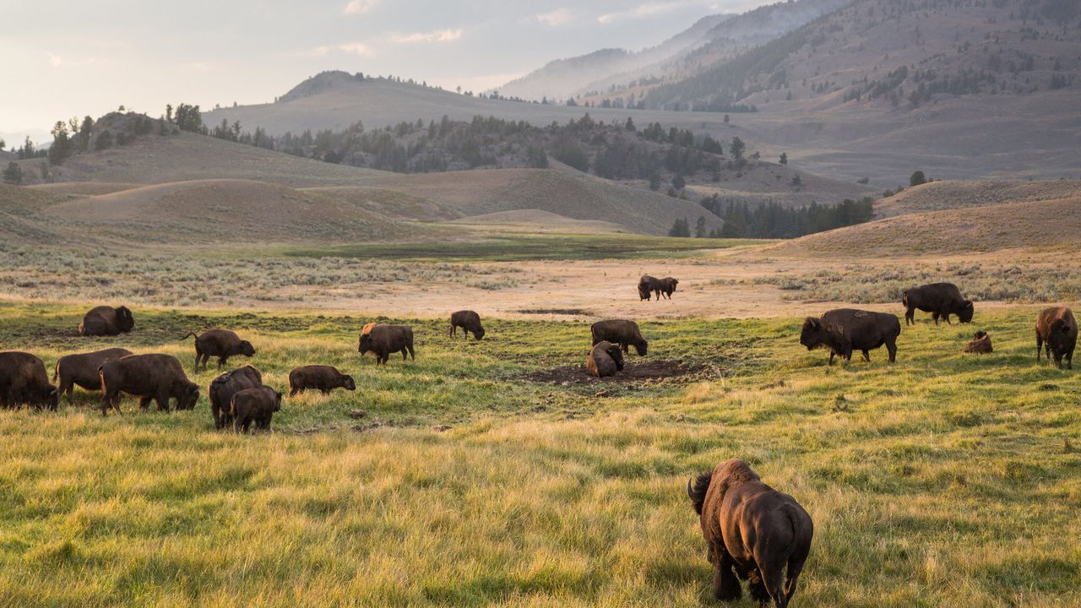
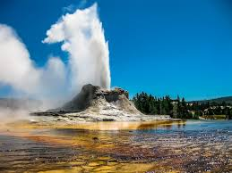
Ecosystem & Climate
  The Core Ecosystem: Yellowstone is the heart of the Greater Yellowstone Ecosystem.
  Diverse Environments: The park features coniferous forests, expansive grasslands, high-elevation alpine zones, and unique hydrothermal areas.
  Subalpine Climate: The park experiences long, brutally cold winters and short, mild summers.
  Unpredictable Weather: Because of the high elevation, sudden storms can hit at any time, and temperatures can swing by 22°C or more in a single day.

Slide 7
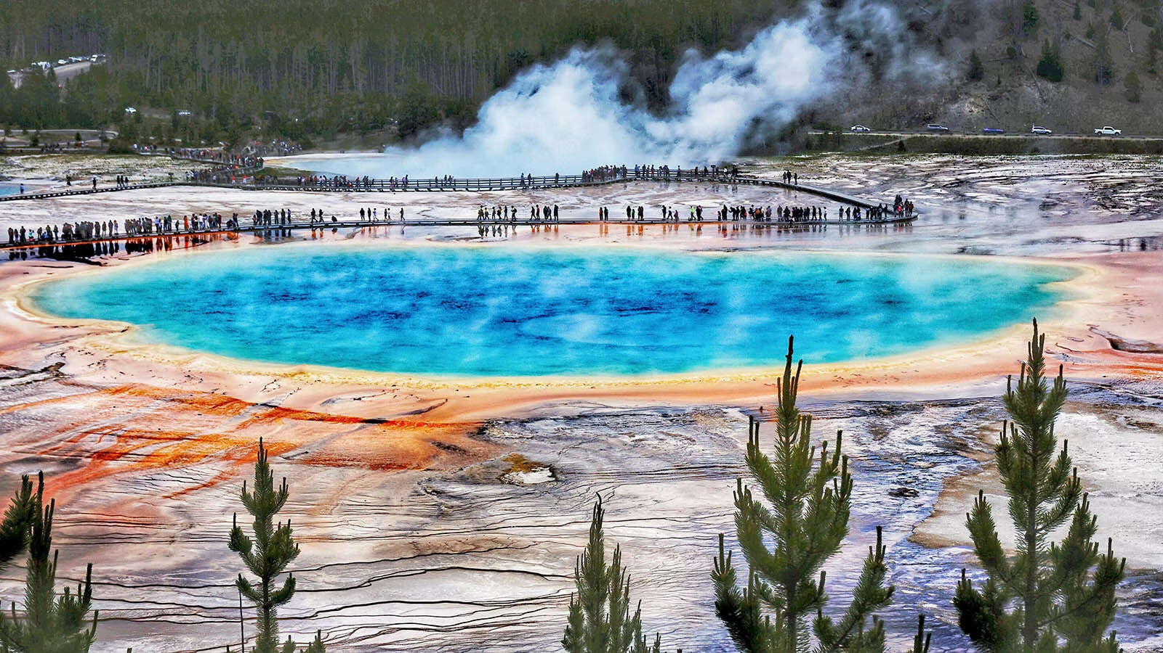
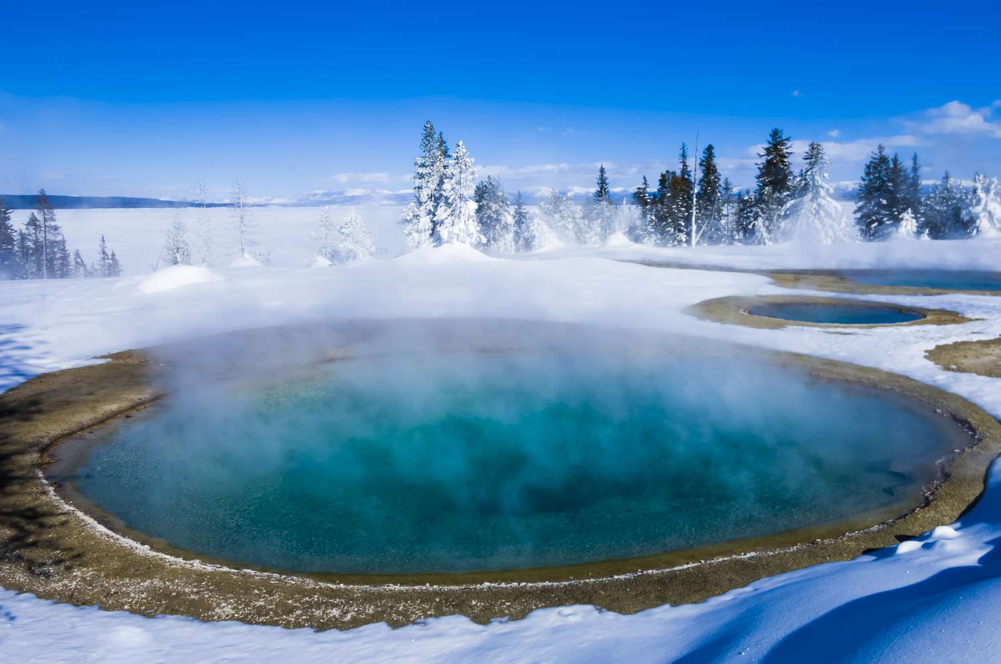
The Seasons
  Summer: Days are mild and pleasant (21°C to 27°C), but temperatures plunge at night (-1°C to 4°C).
  Fall: A rapid transition where days are crisp and nights drop well below freezing, with blizzards possible as early as October.
  Winter: Long, freezing, and snowy, with daytime highs around -18°C to -7°C and an average of 150 inches of snowfall annually.
  Spring: A slow, messy thaw where April brings heavy snow, and May transitions into a mix of rain and melting snow.

Slide 8
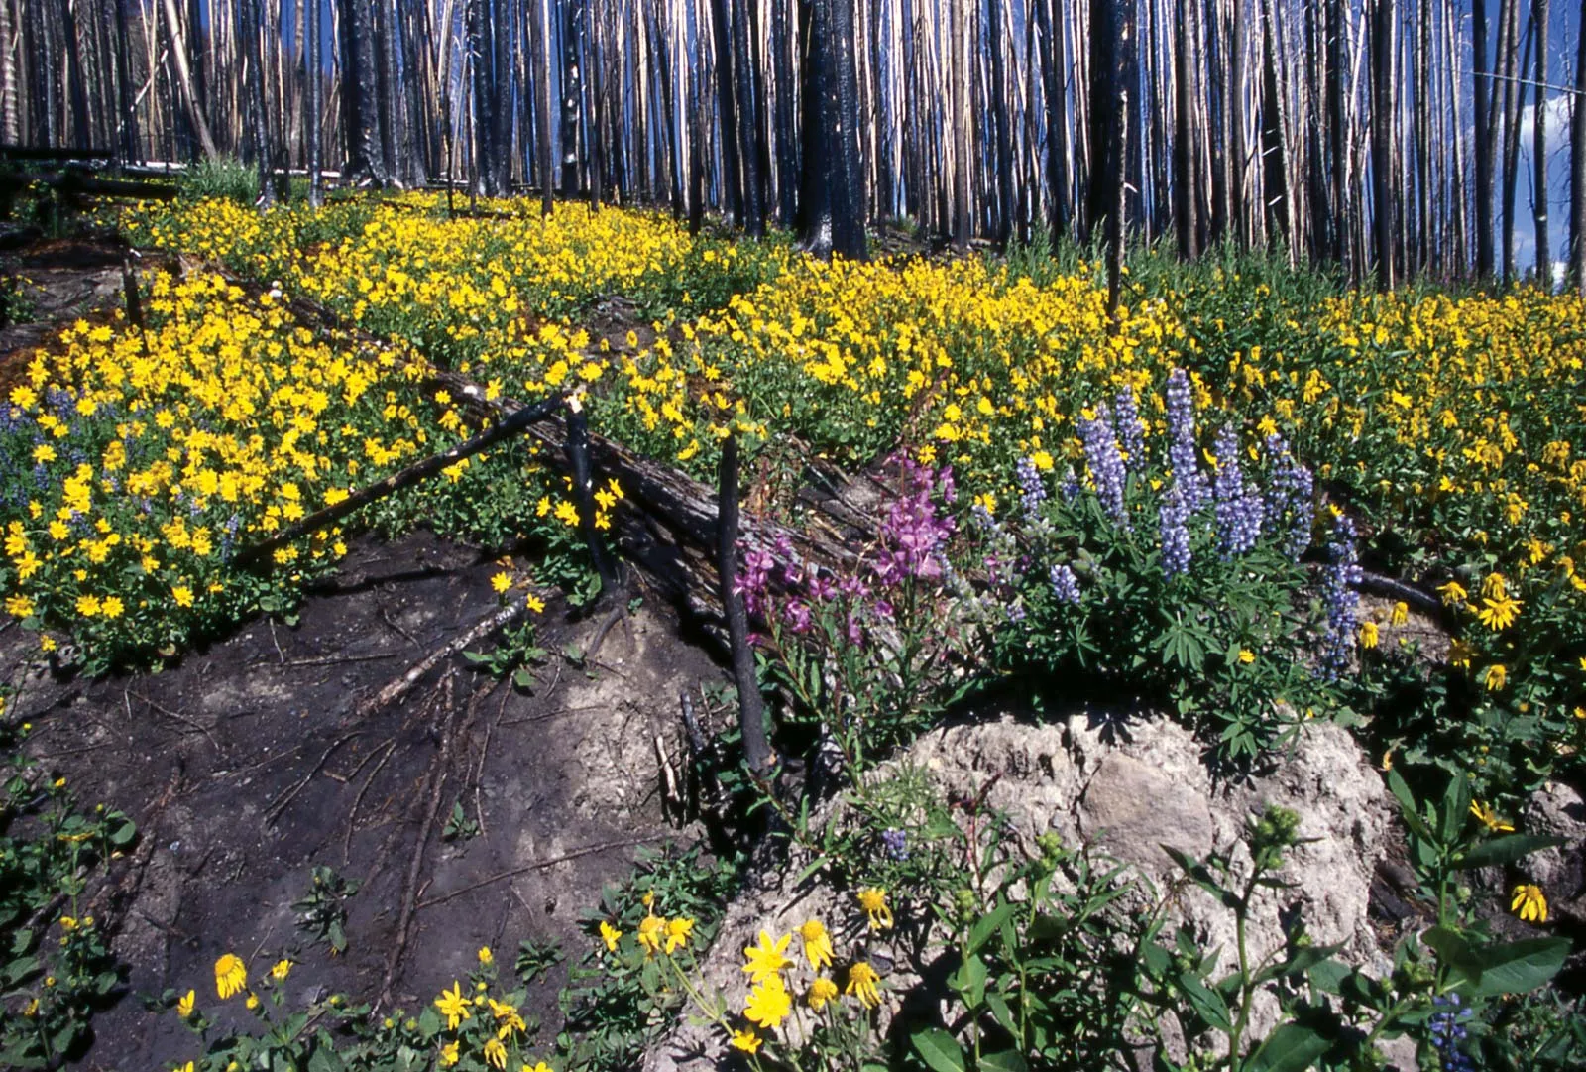
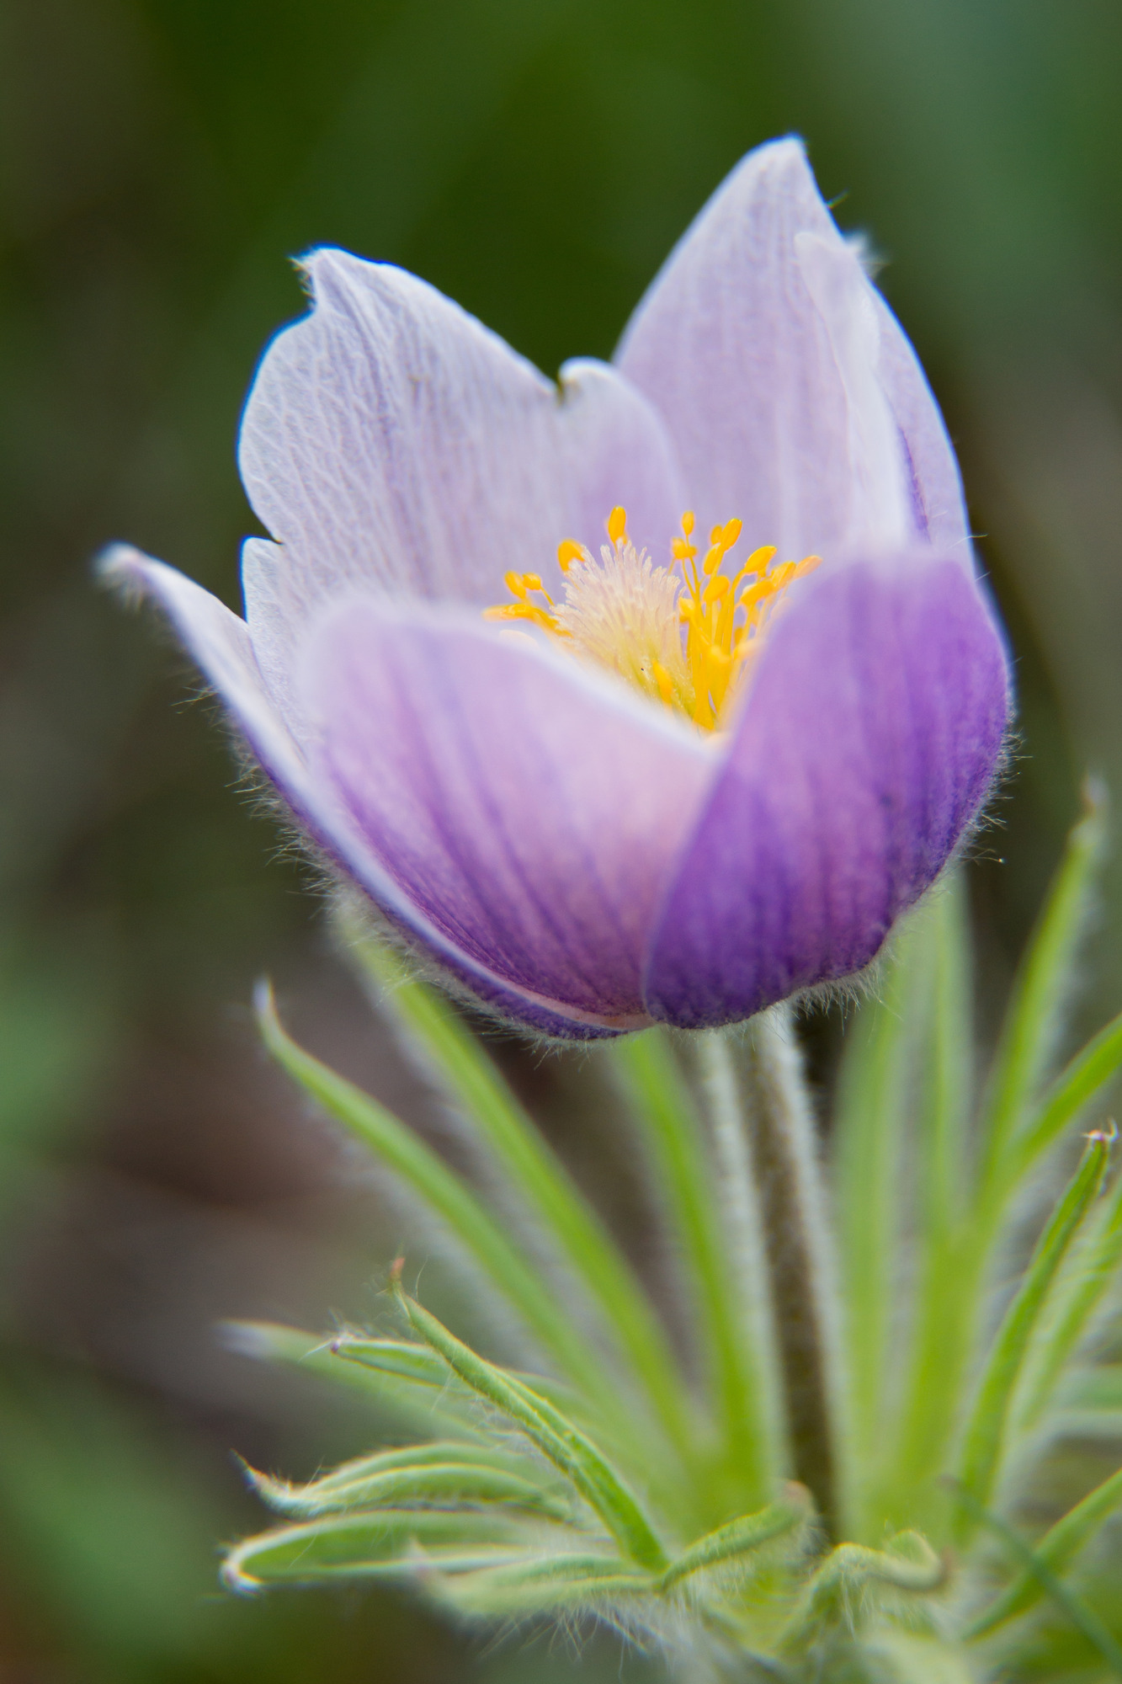
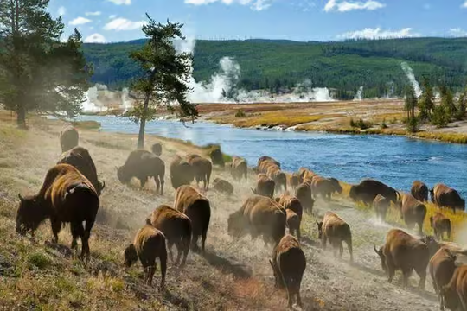
Biological Features

Slide 9

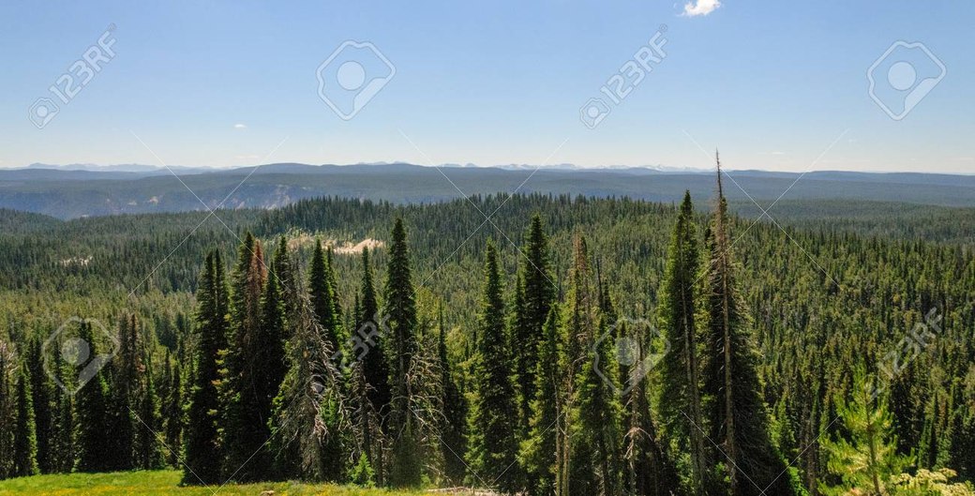
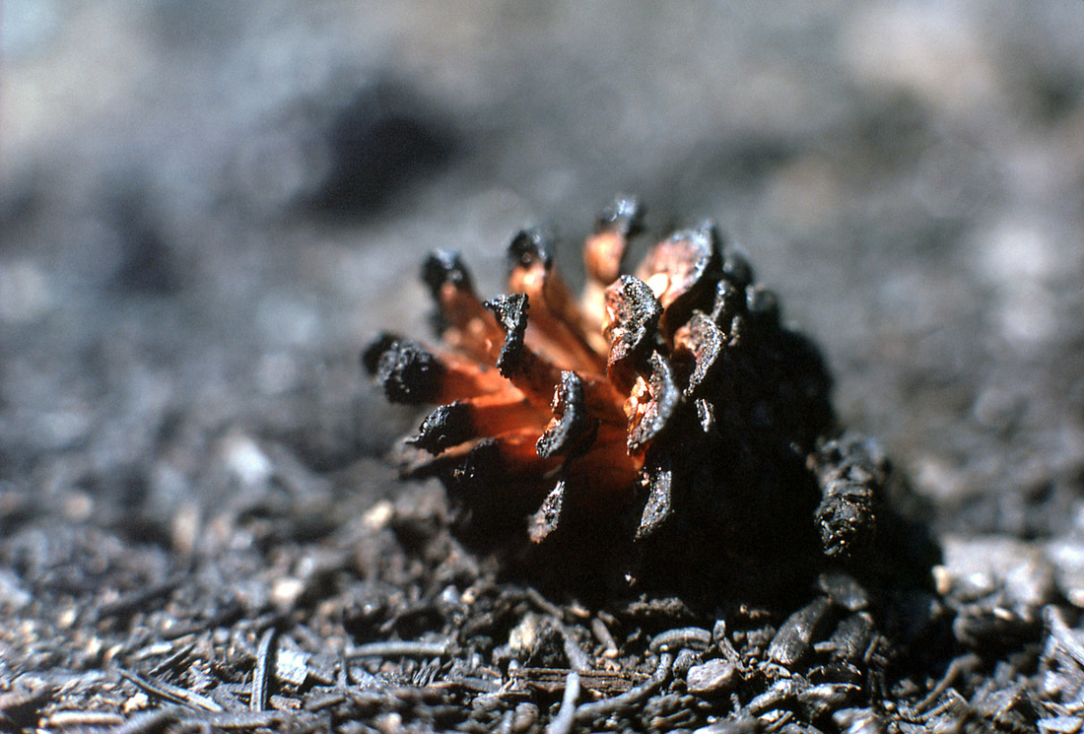
Lodgepole Pine
  Park Dominance: They are the ultimate survivors, making up nearly 80% of Yellowstone's forests.
  Physical Adaptation: They produce "serotinous cones" that are tightly sealed shut by a sticky resin. The cones require the intense heat of a forest fire (at least 45°C) to melt the resin and release seeds.
  Life-cycle Adaptation: Seeds are released onto a bed of nutrient-rich ash after the fire clears out competing plants. The lodgepole pine ensures its offsprings land in an ideal nursery: a sunlit clearing, devoid of competing plants, resting on a bed of highly nutritious ash.

Slide 10
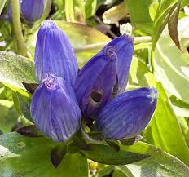
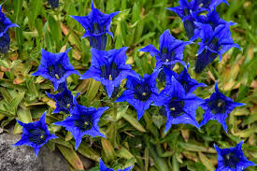
Rocky Mountain Fringed Gentian
  Unique Habitat: Thrives in the warm, damp soils near hot springs and geysers.
  Physical Adaptation:
    Flowers open wide in direct sunlight for pollinators, but tightly coil shut on cloudy days to protect themselves.
    The plant produces highly bitter compounds so large grazing mammals think it tastes terrible and won't eat it.

Slide 11

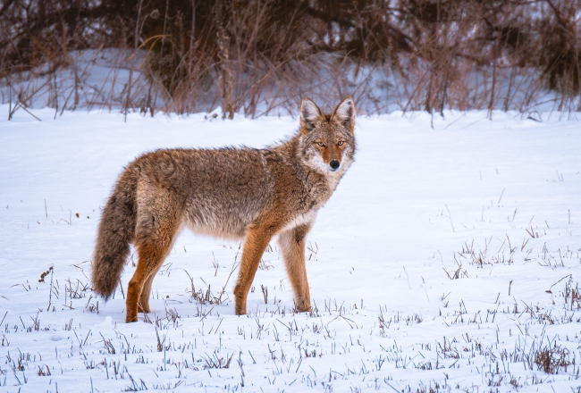
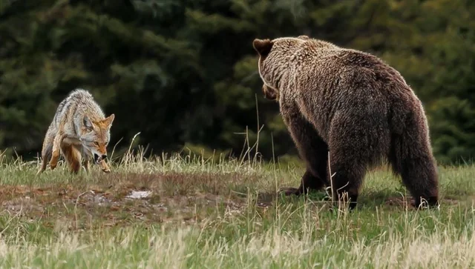
Coyotes
  Physical Adaptation: Grayish-brown fur helps them blend into winter grass to hide from prey and wolves.
  Behavioral Adaptation: They hunt alone or in pairs in the summer, but form packs in the winter for safety in numbers against wolves.
  Diet: They eat small mammals (voles, rabbits) and smaller predators (red foxes, skunks) to reduce food competition.
  Predators: Hunted by gray wolves, cougars, and grizzly and black bears.

Slide 12
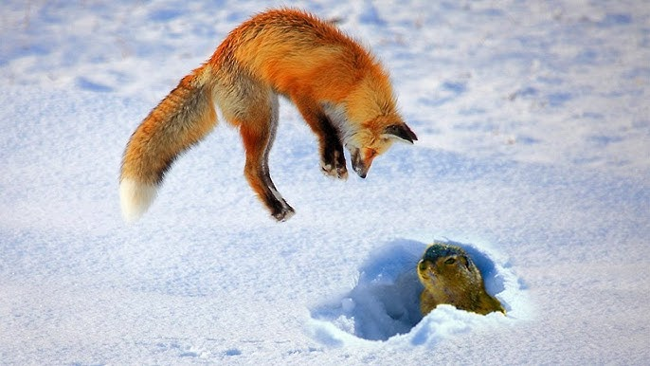
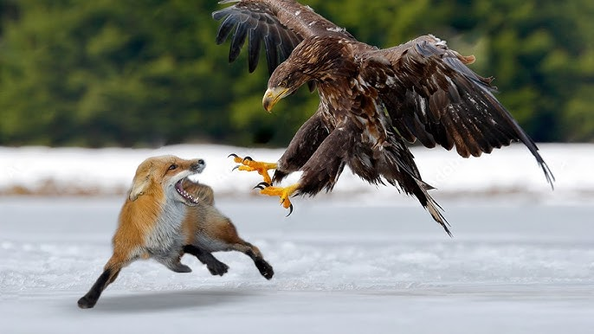
Red Foxes
  Physical Adaptation: Specialized ears hear low-frequency sounds, like mice scratching under several feet of solid snow.
  Behavioral Adaptation : They bury their extra food in the snow or dirt to dig up later when food is scarce
  Diet: Small rodents, birds, insects, and fruits.
  Predators: Coyotes are their number one enemy because they share a similar diet, but they are also hunted by golden eagles, cougars, and bobcats.

Slide 13
Problems
and
Solutions

Slide 14

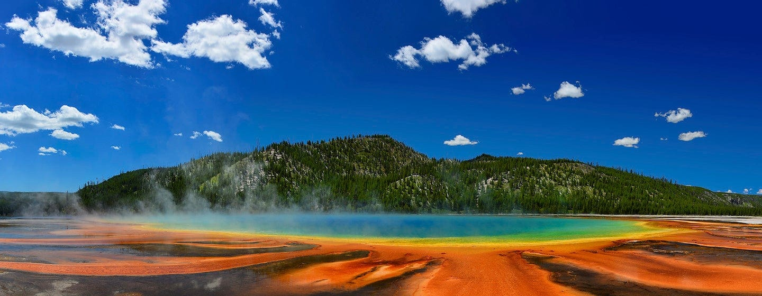
Air Quality
& Pollution
  Usually Great Air: Yellowstone mostly has good or excellent air quality indexes.
  Ozone Index: Typically rated as Good to Fair. Ground-level ozone measured in parts per billion (ppb) are ranging from 20 ppb to 50 ppb which is far below the National Ambient Air Quality standard.
  Drifting Smog: Wind blows dirty air and industrial chemicals from distant farms and cities right into the park, hurting sensitive plants and lakes.
  Summer Smoke: Thick wildfire smoke often gets trapped in the mountainous terrain during the summer.

Slide 15
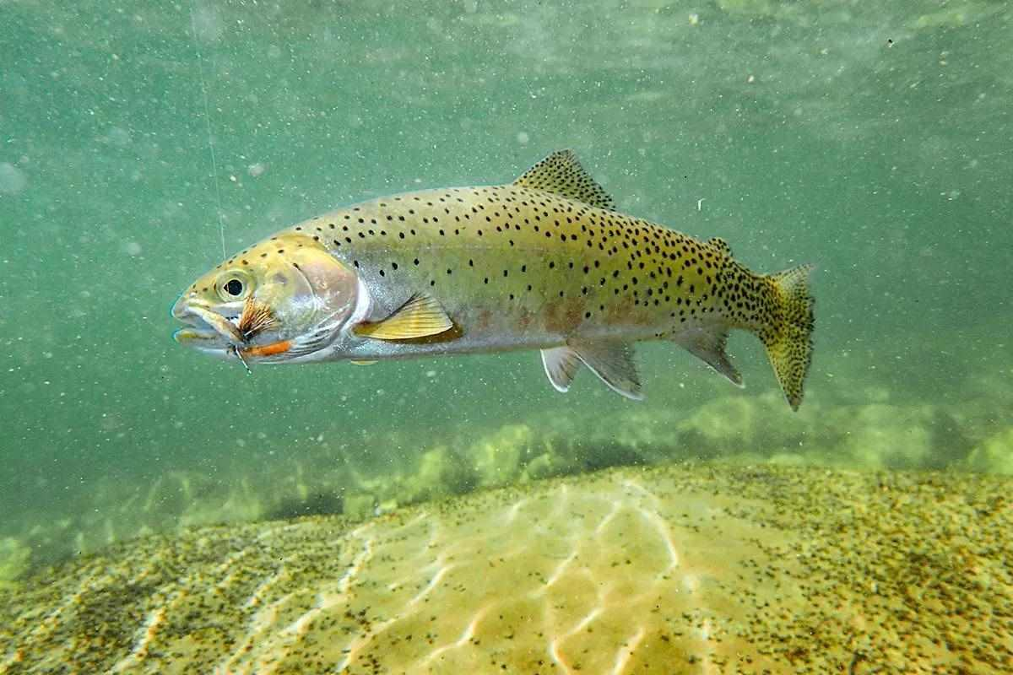
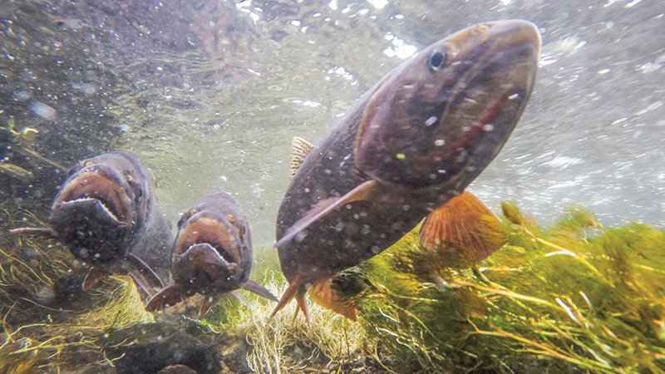
Invasive Lake Trout
  The Problem: Non-native lake trout were illegally introduced to Yellowstone Lake and are destroying the native cutthroat trout population.
  Food Web Disaster: It caused a damaging ripple effect across the entire park's food web. Therefore, this starves grizzly bears and bald eagles that rely on the native trout for food.
  The Solution: The park uses commercial-grade gillnets and sonar tracking to remove millions of lake trout.
  Strict Fishing Rules: Any caught lake trout must be killed, but native cutthroat trout must be released unharmed immediately.

Slide 16
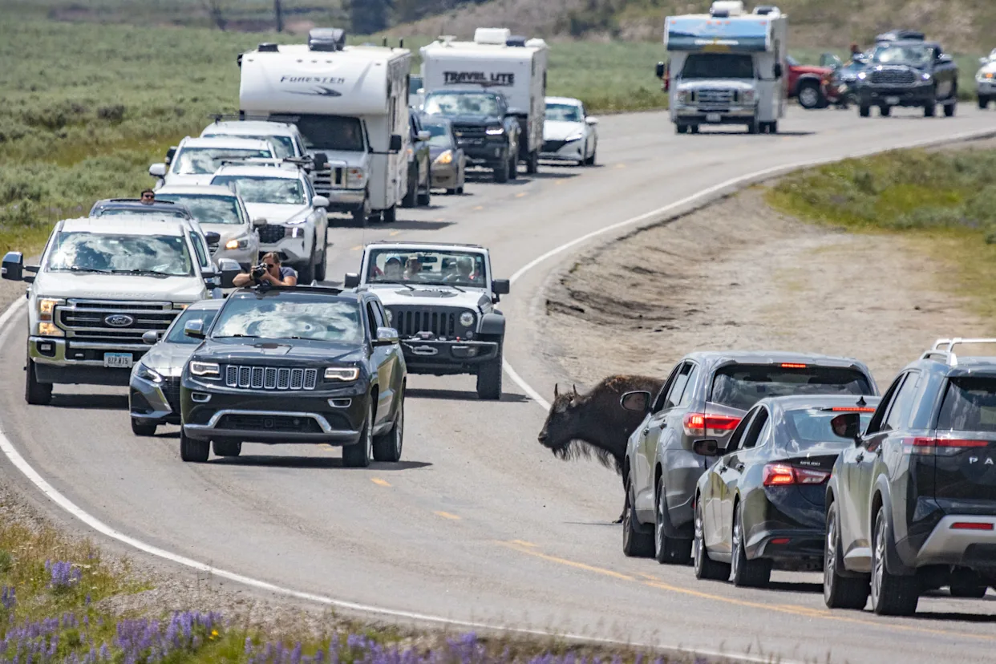
Overtourism
& Infrastructure Strain
  Massive Crowds: Millions of annual visitors cause severe traffic jams on the 350-mile road system and wear down park facilities.
  Bad Behavior: Huge crowds lead to more tourists harassing wildlife and walking into restricted thermal areas.
  Upgrading Facilities: The park is constantly funding the modernization of utility systems, bridges, and water/sewage facilities to handle the volume of people.
  Managing Traffic: Specialized rangers use parking restriction systems and real-time digital app tracking to redirect cars away from overcrowded geysers.

Slide 17
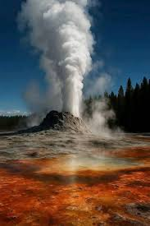
My poem
Yellowstone National Park
By Anna
The geyser shoots up like a rocket so bright,
While dancing steam rises day and night.
Colorful springs sparkle across the land,
A natural treasure, beautiful and grand.
Wild wolves roam freely among the pine trees,
Trout swim carefully through streams with ease.
Antlers shine proudly beneath the sky,
As wildlife wanders peacefully by.
Hikers trek eagerly on every trail,
Photographers capture sights without fail.
Yellowstone is a treasure for all to see,
A wild, historic wonder that will always be.

Slide 18
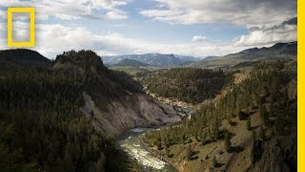
Video

Slide 19
Sources
  https://alwayssomewherenew.com/northamerica/10-must-see-sights-in-yellowstone-national-park
  https://en.wikipedia.org/wiki/Yellowstone_National_Park
  https://www.yellowstonenationalparklodges.com/stay/plan/weather/
  https://www.nps.gov/yell/learn/nature/greater-yellowstone-ecosystem.htm
  https://www.nps.gov/yell/learn/nature/coyote.htm
  https://www.nps.gov/yell/learn/nature/red-fox.htm
  https://bendbranches.com/2019/04/12/fringed-gentian-friday-flowers/
  https://www.nps.gov/yell/learn/nature/airquality.htm
  https://www.nps.gov/subjects/air/humanhealth-ozone.htm
  https://www.nps.gov/subjects/air/current-data.htm?site=yell&location=water-tank&

Slide 20

Thank You
and Have a Great Day!

