Slide 1


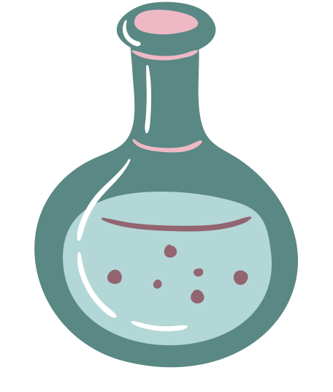
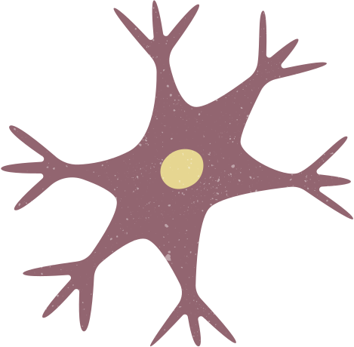
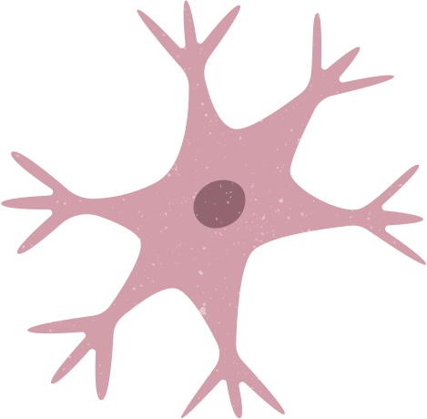

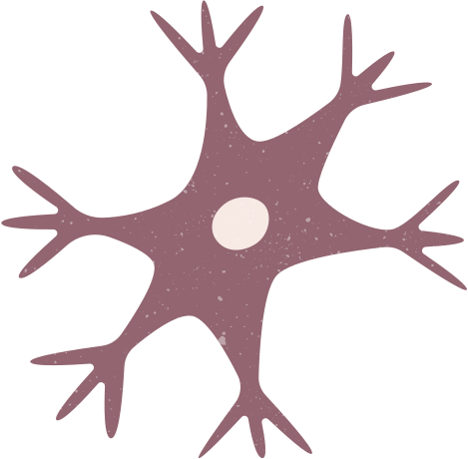
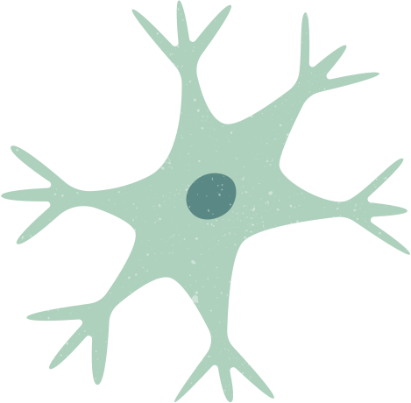
Respiratory
system
TEAM 2 COMPANY

Slide 2
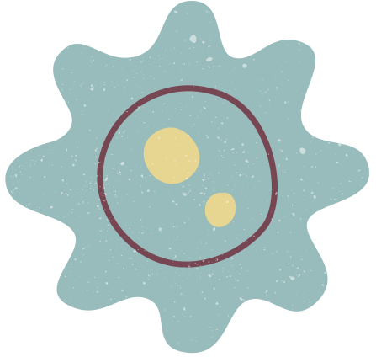
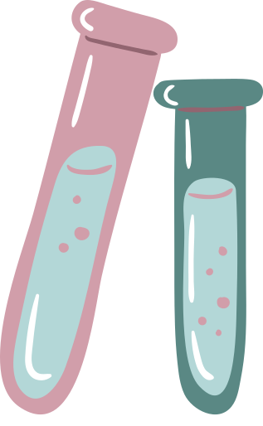

Introduction
Oxygen is the most necessary thing that keeps us alive. But what helps us take in oxygen? The Respiratory system! The Respiratory system helps us breathe by taking oxygen (02) from outside and releasing carbon dioxide (CO2) from our body to the outside.

Slide 3
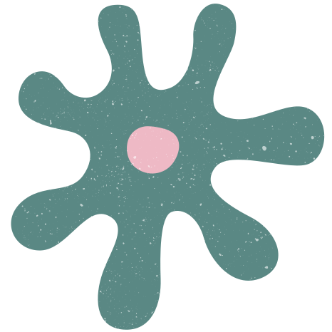
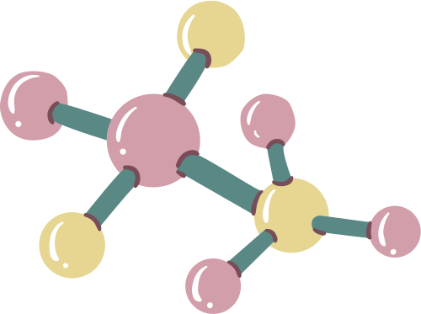

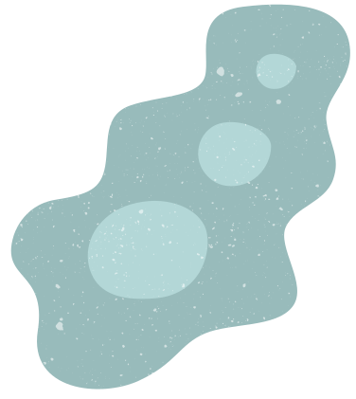
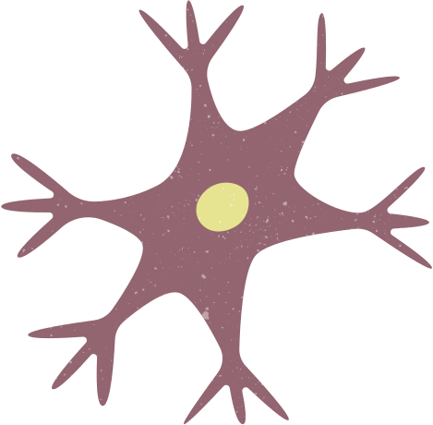
01
RESPIRATORY
PARTS

Slide 4

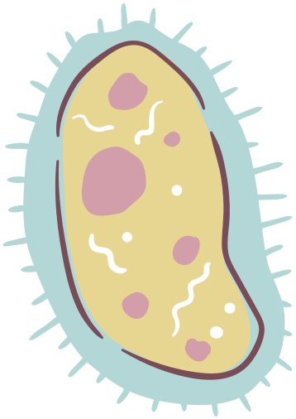
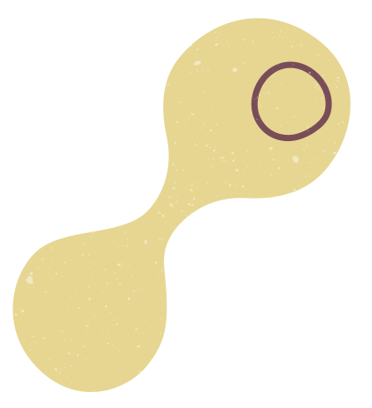

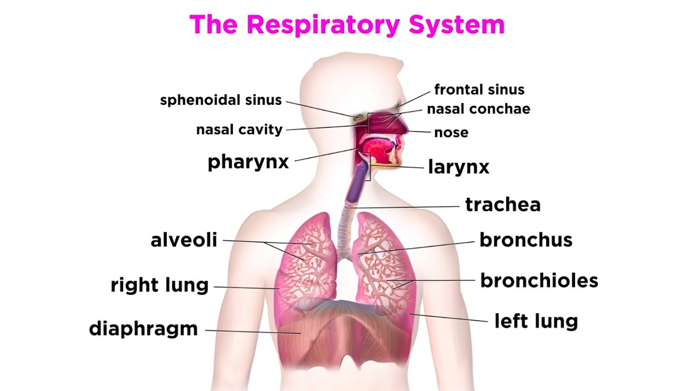
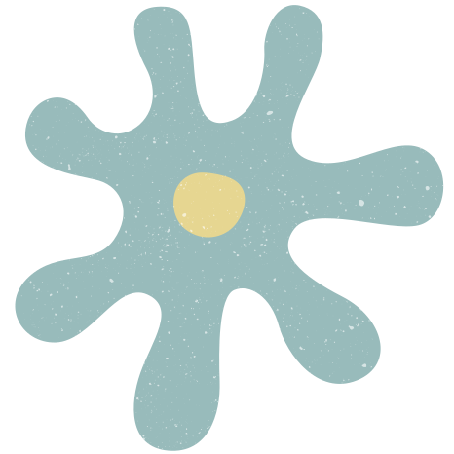
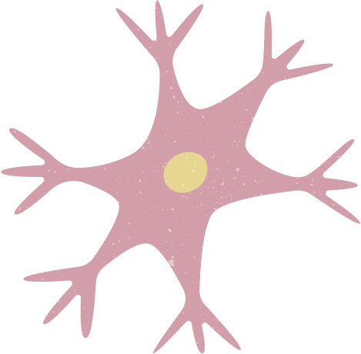
PARTS
FRONTAL SINUS
NASAL CONCHAE
NOSE
SPHENOIDAL SINUS
NASAL CAVITY
PHARYNX
LARYNX
TRACHEA
RIGHT LUNG & LEFT LUNG
BRONCHUS
ALVEOLI
BRONCHIOLES
DIAPHRAGM

Slide 5
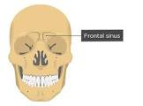
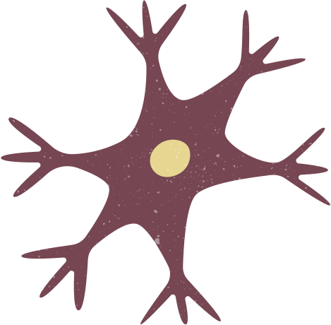
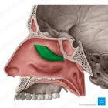
01
FRONTAL SINUS
The mucosal lining in the frontal sinus helps to warm and humidify inhaled air entering from the nasal cavity,
02
NASAL CONCHAE
Due to its highly convoluted and 'scroll-like' arrangement, the main function of the nasal concha is to increase the surface area of the nasal cavities in order to provide warming and humidification of air as it passes to the lungs.

Slide 6
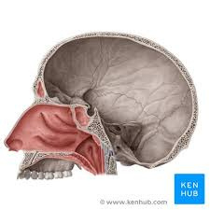

03
NOSE AND NASAL CAVITY
Humidify, warm, filter, and act as a conduit for inspired air, as well as protect the respiratory tract through the use of the mucociliary system.
04
SPHENOIDAL SINUS
Of all your sinuses, your sphenoid sinus is the farthest back in your skull. Your sphenoid sinuses make mucus that clears germs and allergens out through your nose.

Slide 7
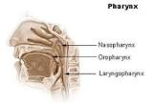
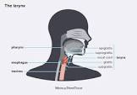
05
PHARYNX
The pharynx acts as a passageway for air to enter the larynx and lungs and food and liquid to enter the esophagus. It also plays a role in speech. The pharynx is about 5 inches long, depending on body size.
06
LARYNX
The primary function of the larynx in humans and other vertebrates is to protect the lower respiratory tract from aspirating food into the trachea while breathing. It also contains the vocal cords and functions as a voice box for producing sounds, i.e., phonation.

Slide 8
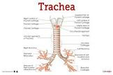
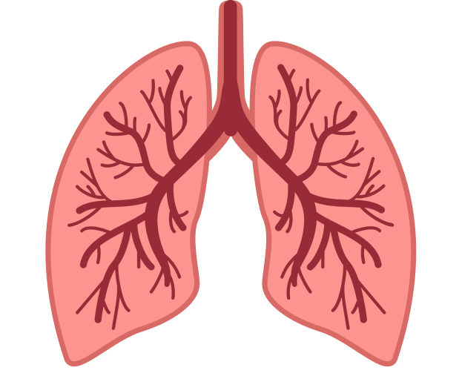
07
TRACHEA
The primary function of the trachea is to allow passage of inspired and expired air into and out of the lung.
08
LUNGS
They bring oxygen into our bodies and send carbon dioxide out.

Slide 9
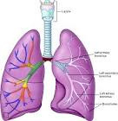
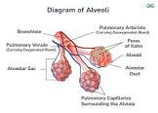
09
BRONCHUS
Your bronchi work as passageways that carry air to and from your lungs. Your bronchi are lined with mucus, which moisturizes the air along the way and traps foreign particles, like viruses, bacteria and dust.
10
AVEOLI
Alveoli are microscopic balloon-shaped structures located at the end of the respiratory tree. They expand during inhalation, and shrink during exhalation. These tiny air sacs are the site where gas exchange between inspired air and the blood takes place.

Slide 10
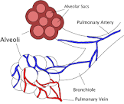
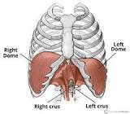
11
BRONCHIOLES
At the end of your bronchi, your bronchioles carry air to your alveoli. There, oxygen transfers from your lungs to your blood.
12
DIAPHRAGM
When you breathe in, your diaphragm contracts (tightens) and flattens, moving down towards your abdomen. This movement creates a vacuum in your chest, allowing your chest to expand and pull in air.

Slide 11
02
HOW SCIENTISTS RESEARCH THE RESPIRATORY SYSTEM

Slide 12
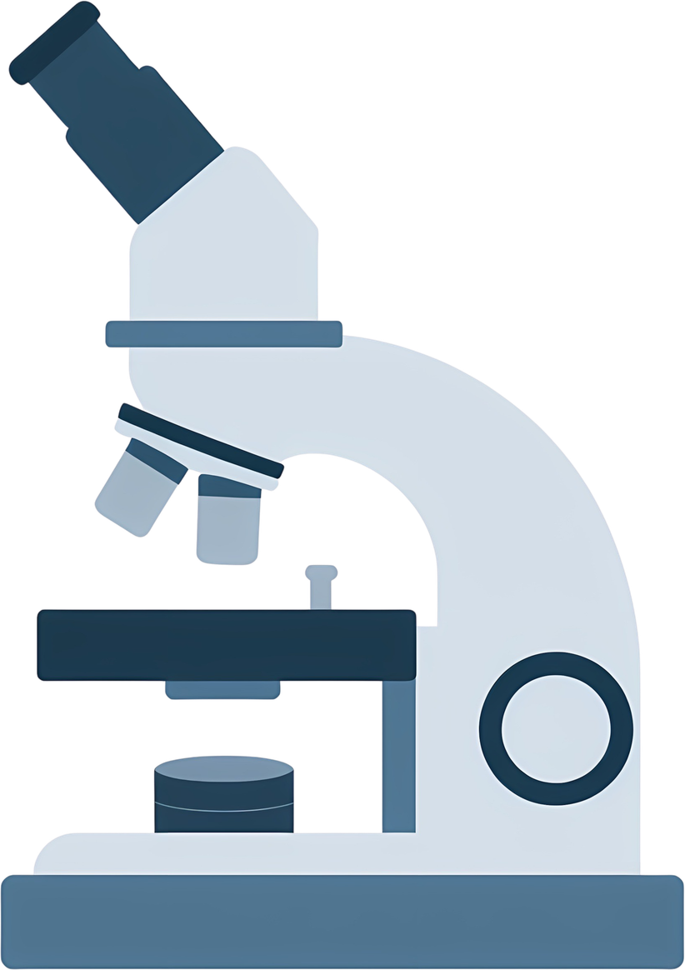
Scientists research the respiratory system by looking at how lungs work from the smallest parts to the whole body. In labs, they grow lung cells to see how germs like viruses infect them and how pollution harms them. They also study animals like mice to test new medicines safely before giving them to humans. To see inside the body, scientists use special pictures called CT scans and MRIs to watch how air moves through the lungs. They also use tools like a spirometry test, which measures how much air a person can breathe out. Finally, they study genes to find out why some people get inherited lung diseases, helping them create better treatments.

Slide 13

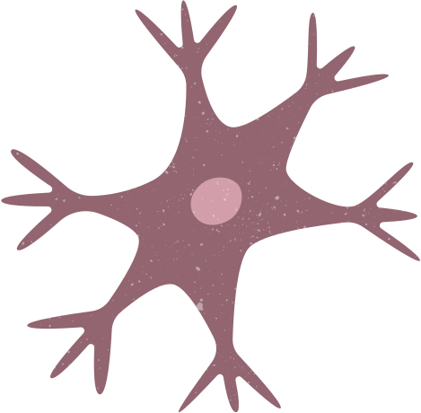
THANK YOU!
see you next time!!
www.reallygreatsite.com

