Slide 1
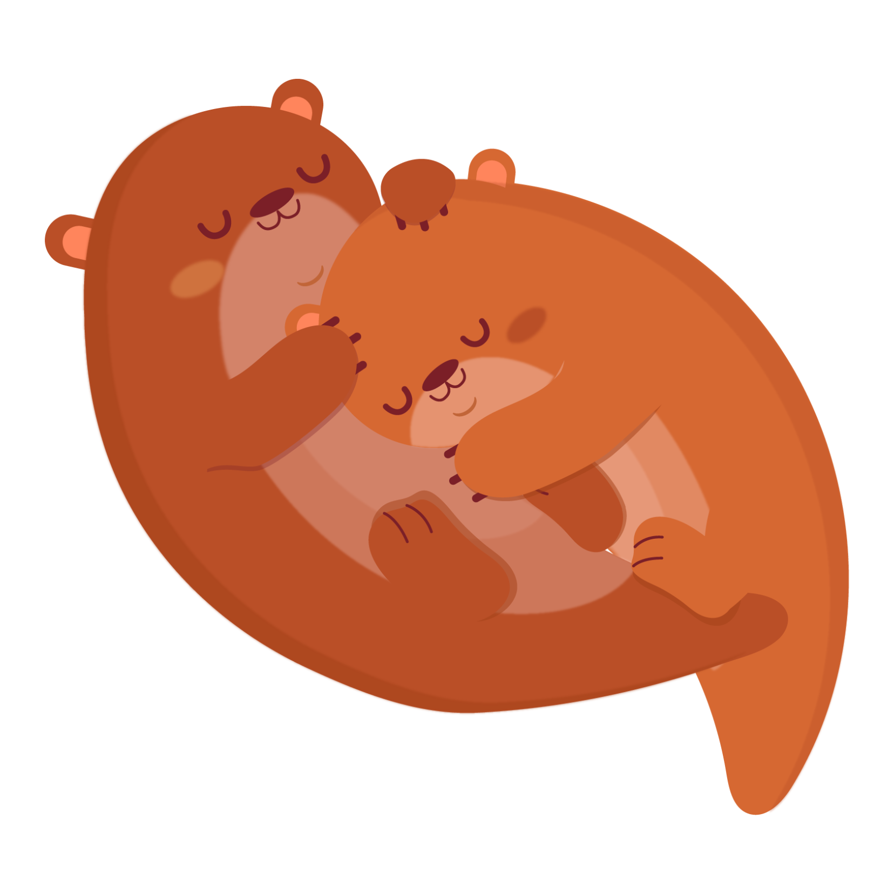
Otter
Vũ Hạnh Linh-Suri-4B2

Slide 2
Otters
Suri-4B2

Slide 3
-Table of contents-
01
About Otters<3
03
Otters life cycle<3
02
Otters Diet<3
04
Otters Facts<3

Slide 4
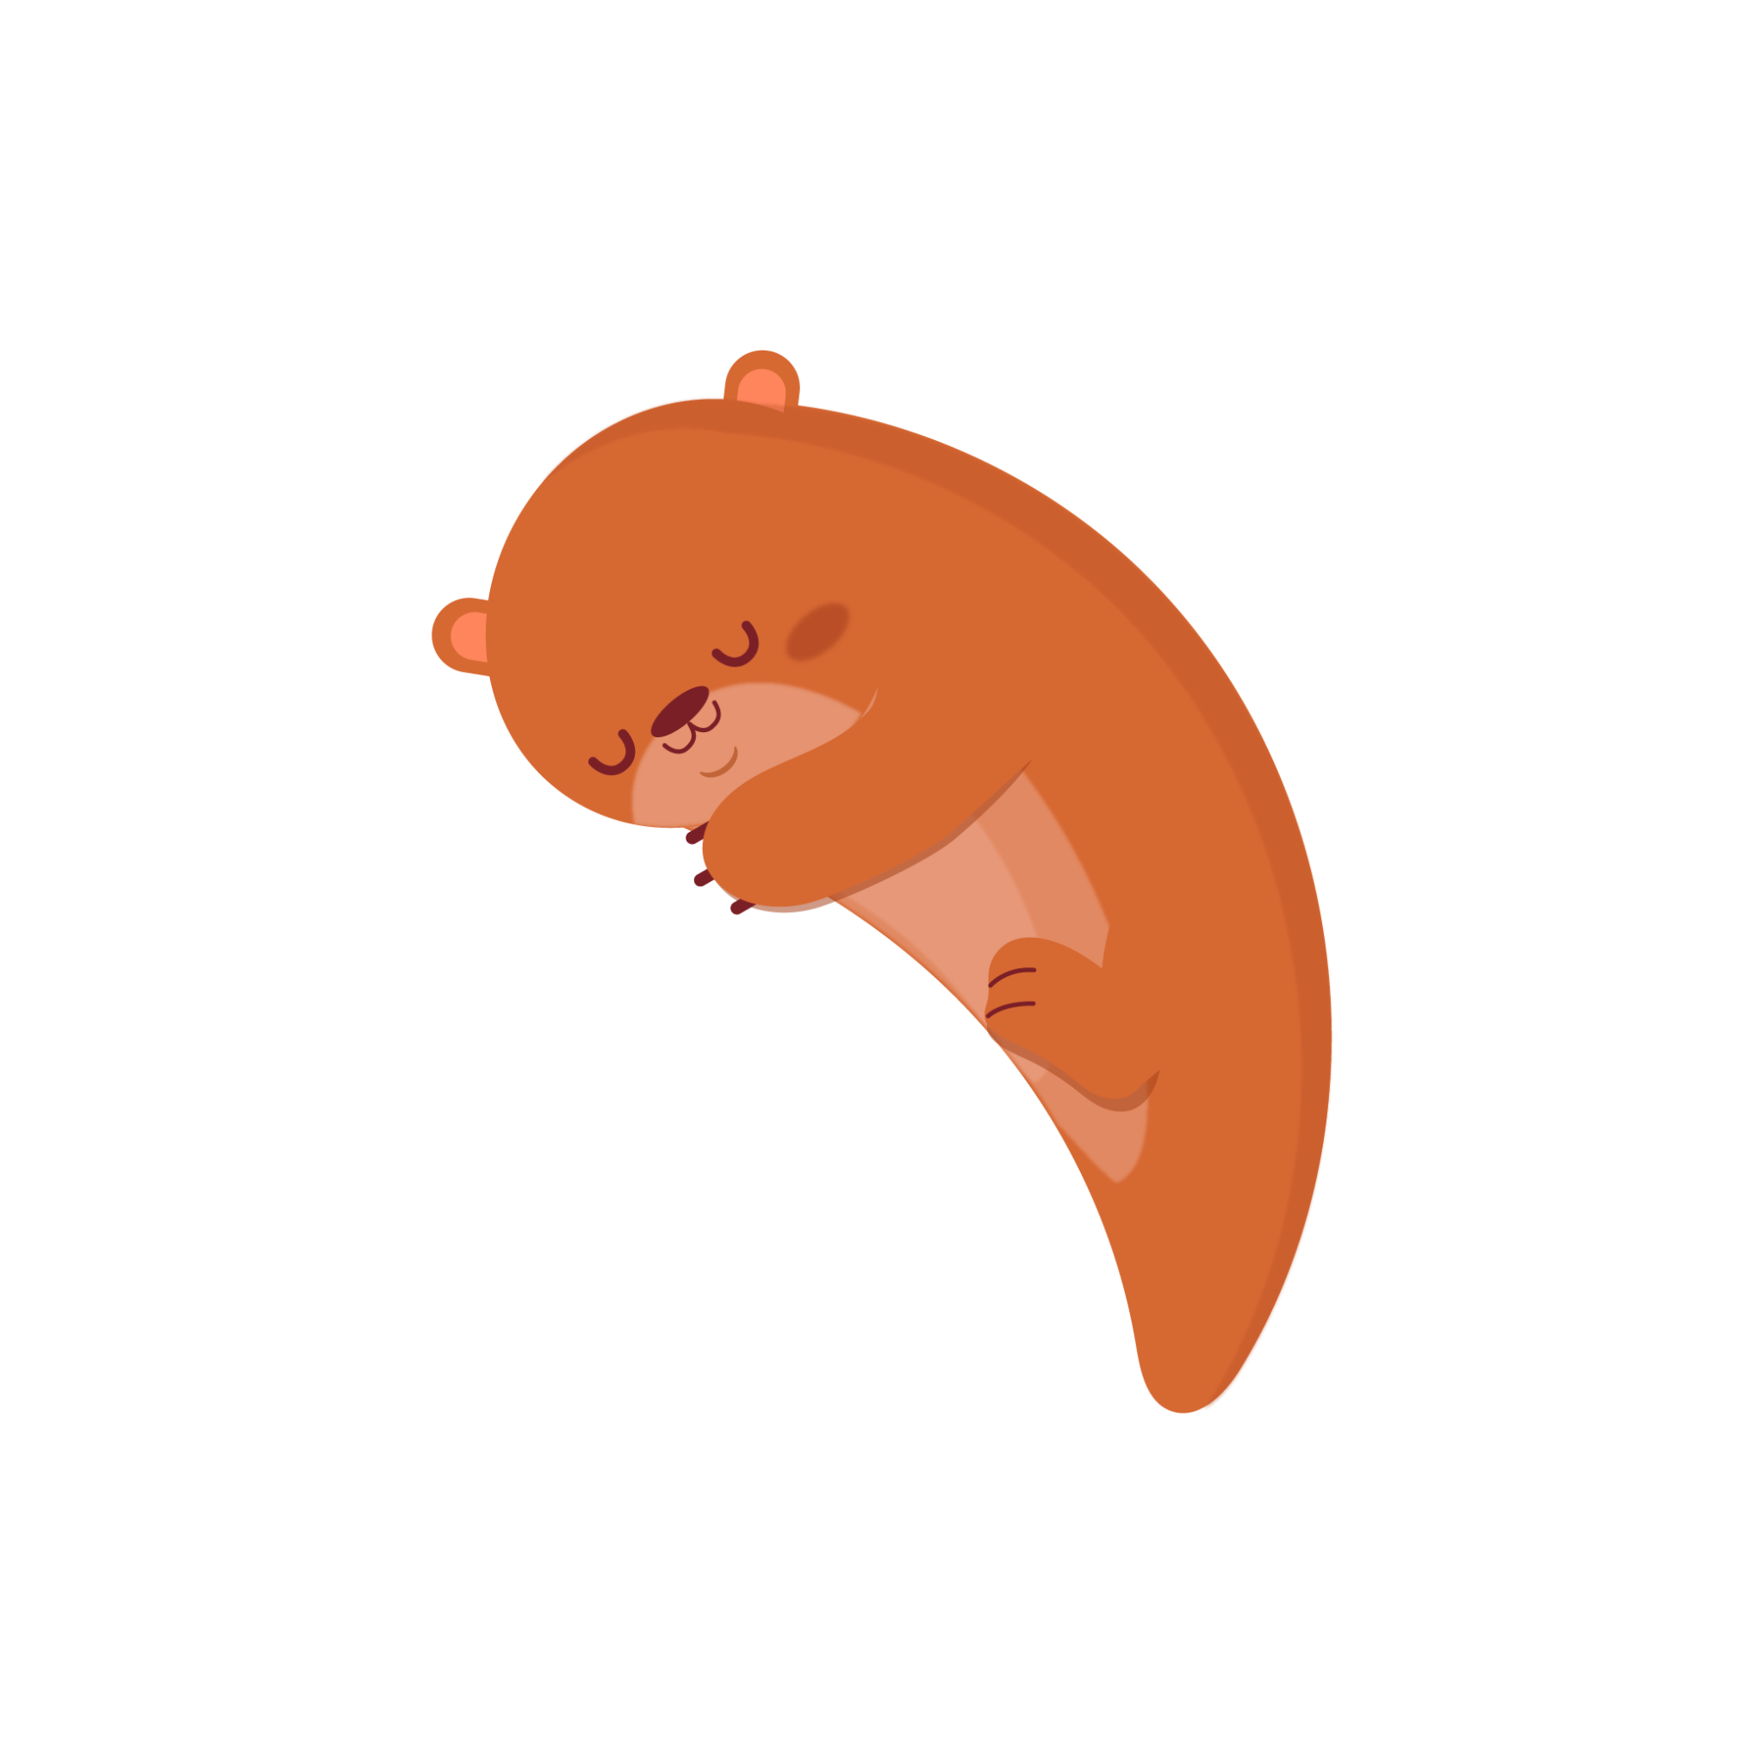
About otter<3
01

Slide 5
01
About otters<3

Slide 6
An Otter is a
MAMMAL

Slide 7
Otters live in

Slide 8
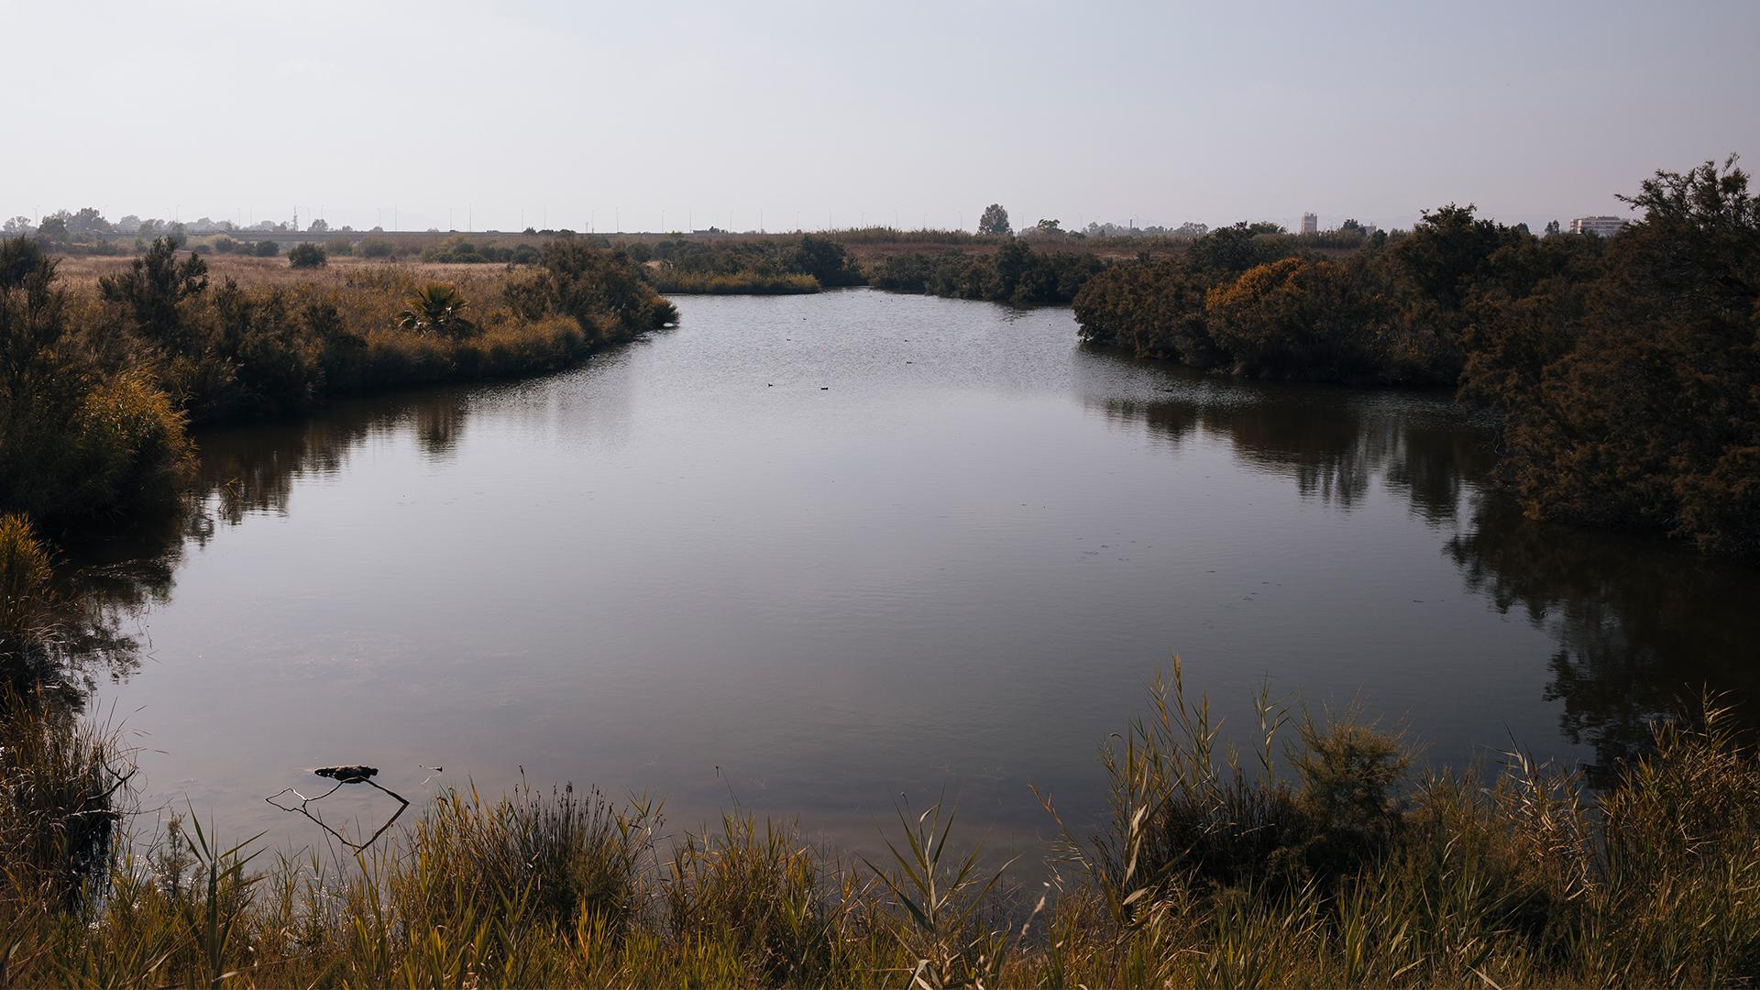
RIVERS

Slide 9
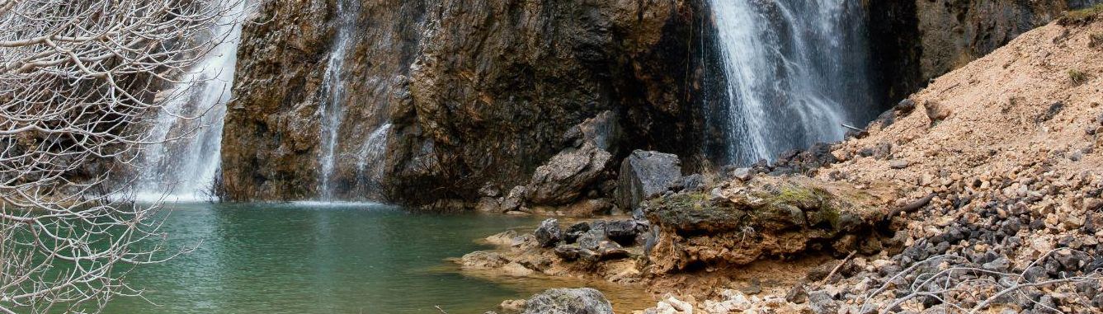
Lakes

Slide 10
Lake

Slide 11
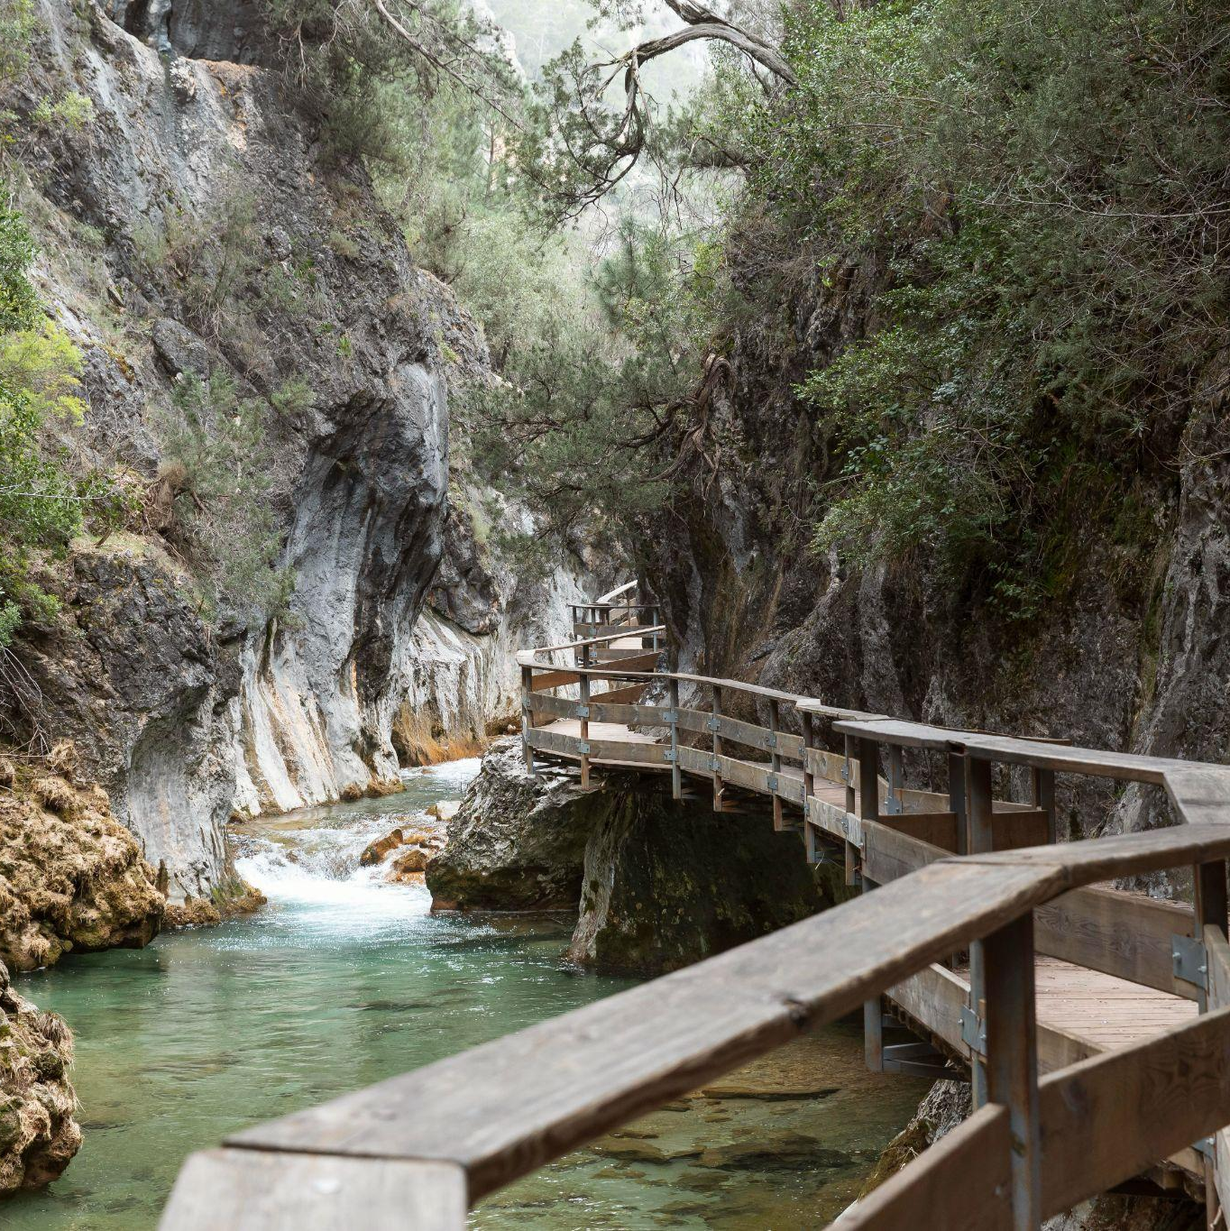
Wetlands
Vùng Đầm Lầy

Slide 12
Wetlands

Slide 13
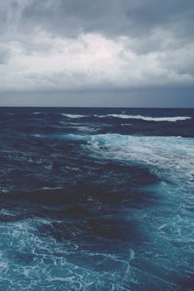
ceans

Slide 14
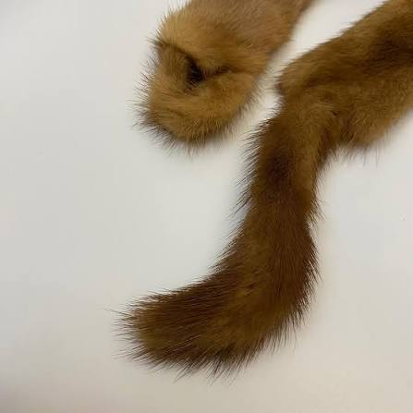
They have thick fur that helps them keep warm
Otter
Their fur
Rái Cá
Lông của tụi Rái Cá

Slide 15
They have thick fur that helps them keep warm
Otters
Their fur

Slide 16
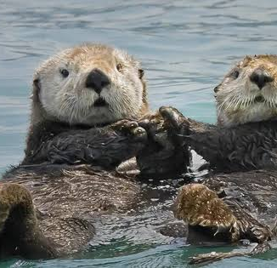
Otters are good at swimming

Slide 17
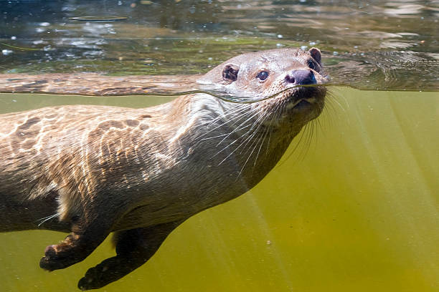
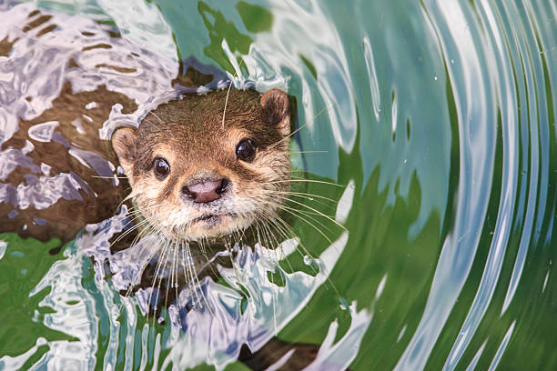
They can swim at speeds up to 14 kilometers per hour.

Slide 18
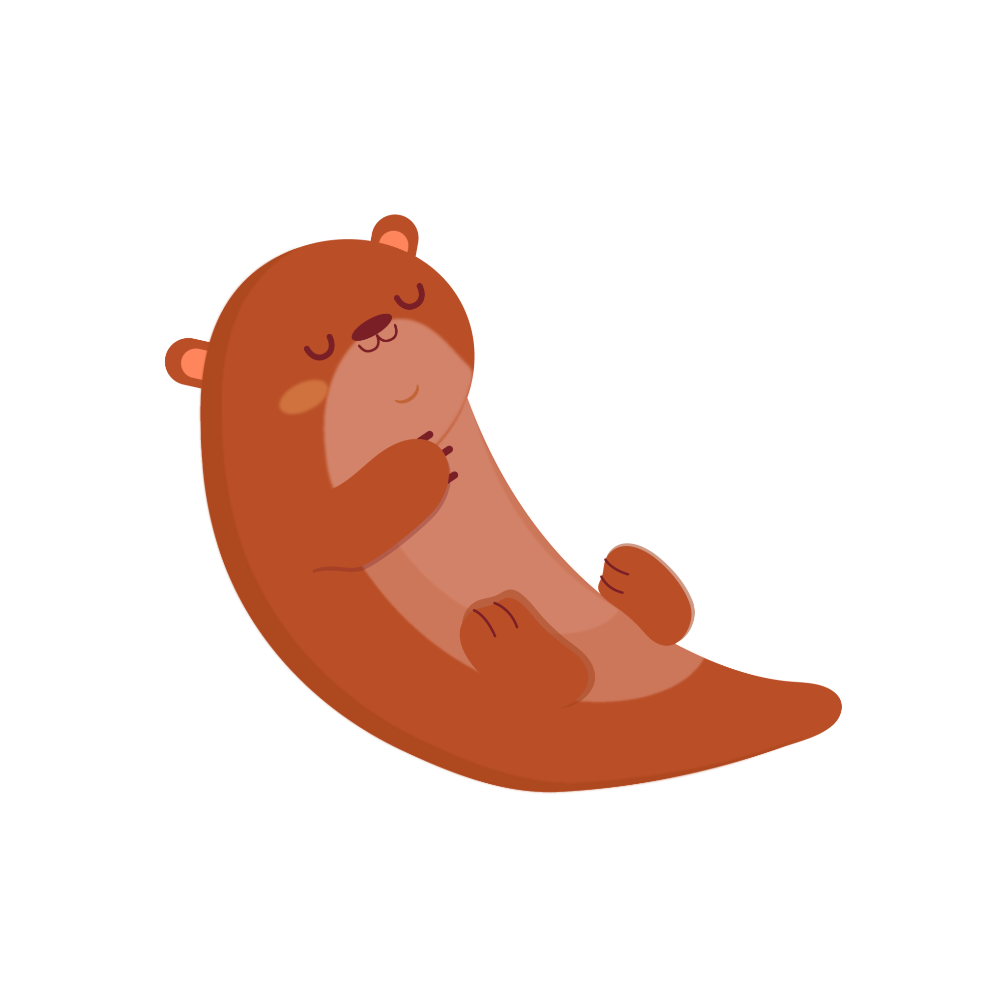
Otters diet

Slide 19
02. Otters diet

Slide 20
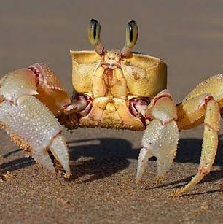
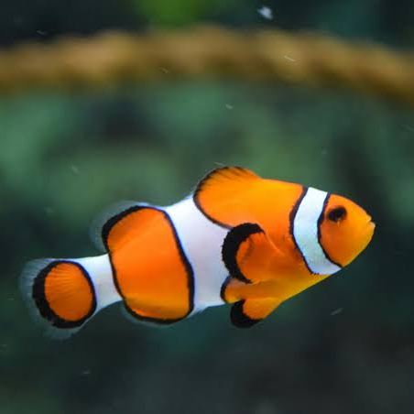
Fish
Crabs
Otters eat seafood
For example:
Shrimp

Slide 21
Fish
Crabs
Shrimp
Otters eat seafood
For example:
Cá
Tôm

Slide 22
Fish
Shrimp
Otters eat seafood
For example:
Crabs
Tôm
Cua

Slide 23
Shrimp
Otters eat seafood
Fish
For example:
Crabs
Cá
Cua

Slide 24
And they hunt for food in the water^^

Slide 25
03
Life cycle of an otter
You can enter a subtitle here if you need it

Slide 26
03
Life cycle of an otter

Slide 27
Birth
An otter begins its life when it is born.
Otters do not hatch from eggs because they are mammals.

Slide 28
3.1 Pup

Slide 29
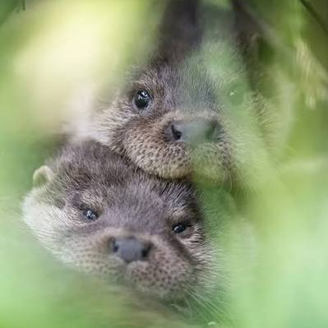
A baby otter is called a pup.

Slide 30
A baby otter is called a pup.

Slide 31
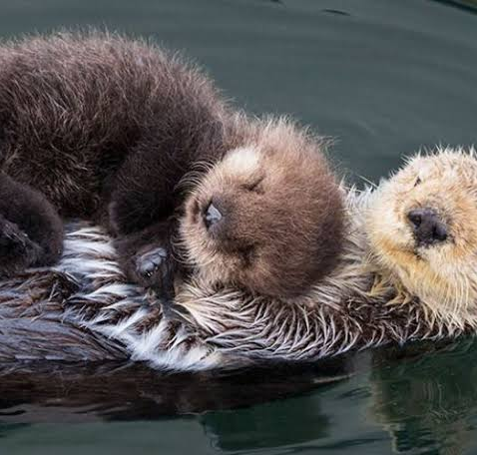
The pup depends on its mother for food and protection.

Slide 32
3.2 Young Otters

Slide 33
Young otters learn how to swim

Slide 34
3.3 Adult Otters

Slide 35
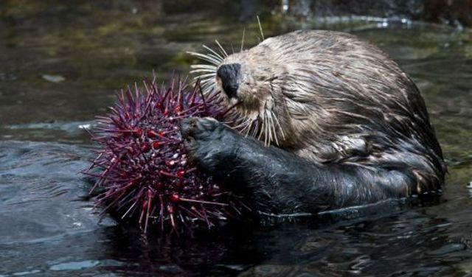
Adult otters can find their own food.
They are able to reproduce and have pups.

Slide 36
They also learn how to hunt and survive
Chúng cũng học cách săn mồi và sinh tồn.

Slide 37
They also learn how to hunt and survive.

Slide 38
3.4 New Generation

Slide 39
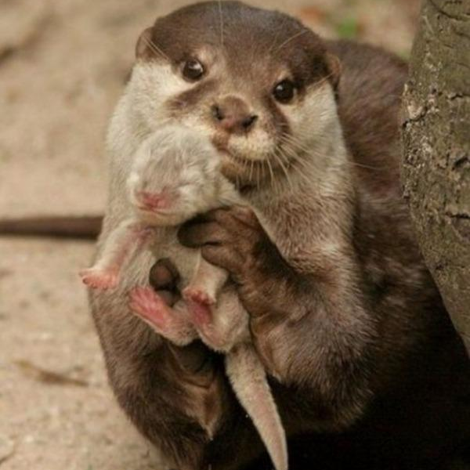
Adult otters have pups of their own.
Rái cá trưởng thành sinh ra thế hệ con non mới.

Slide 40
Adult otters have pups of their own.

Slide 41
The life cycle then starts again.

Slide 42
4. Otters Facts

Slide 43
Some otters use rocks to break and open shells.

Slide 44
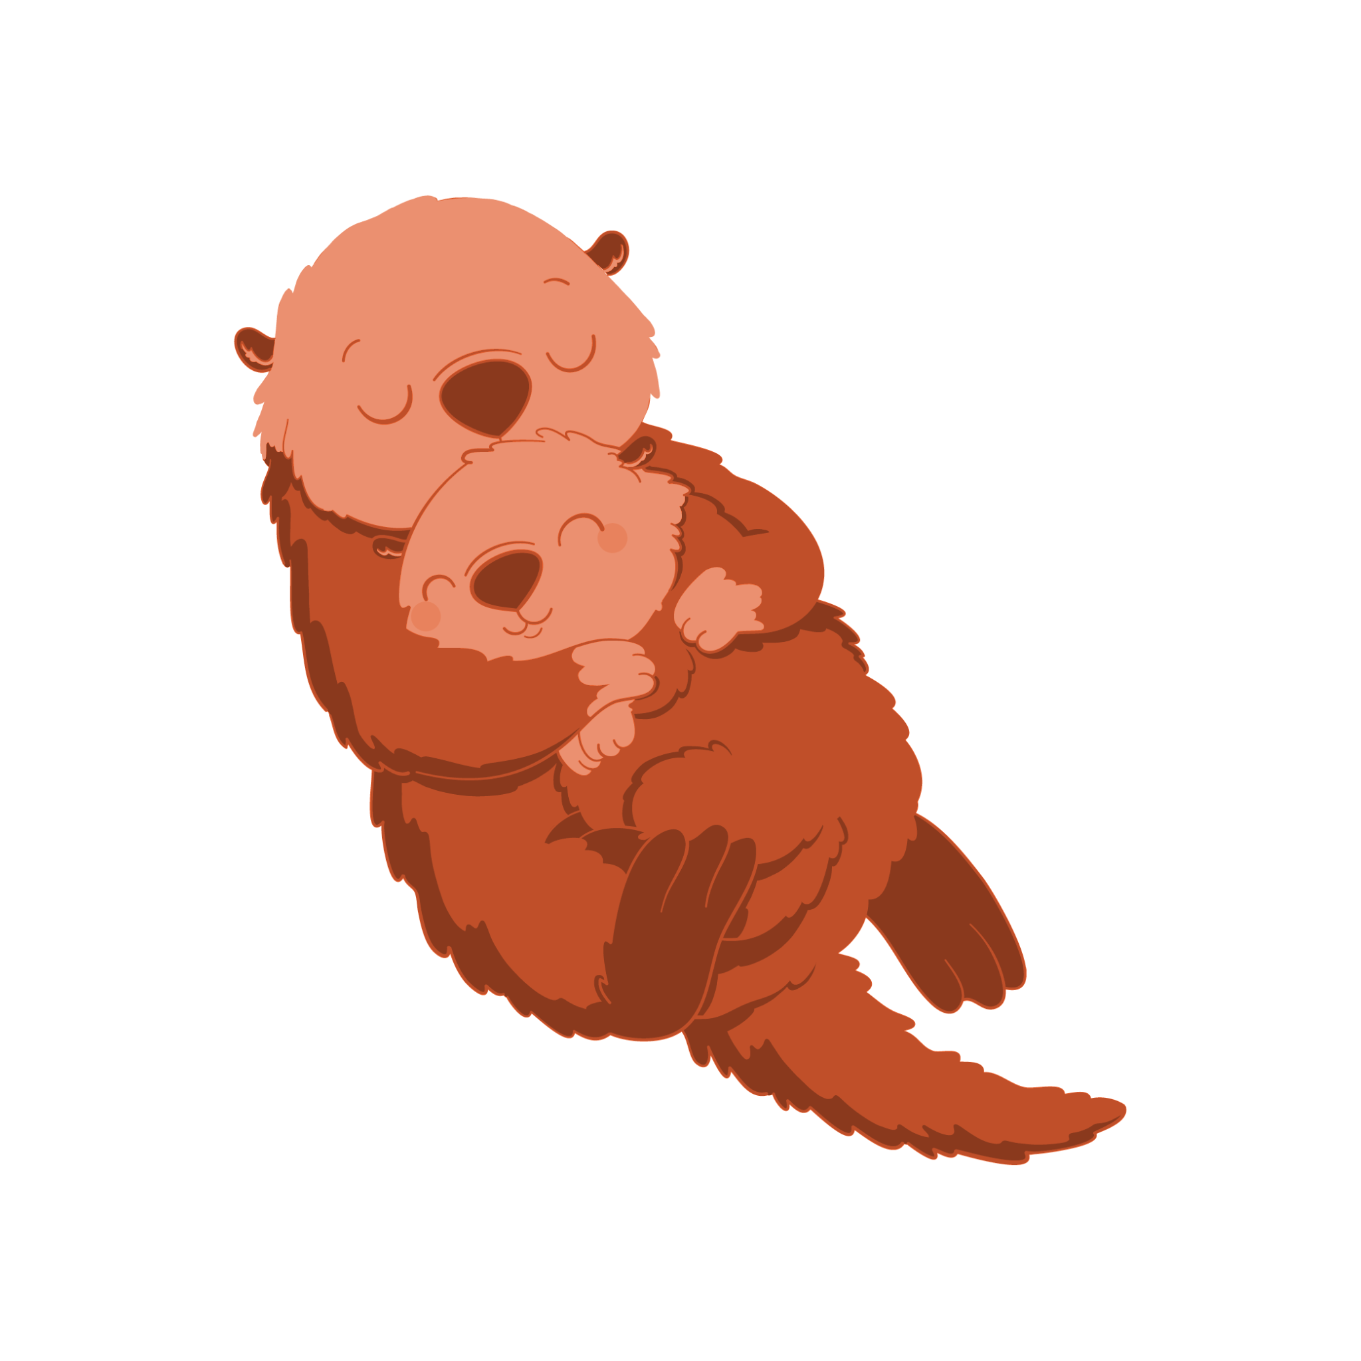
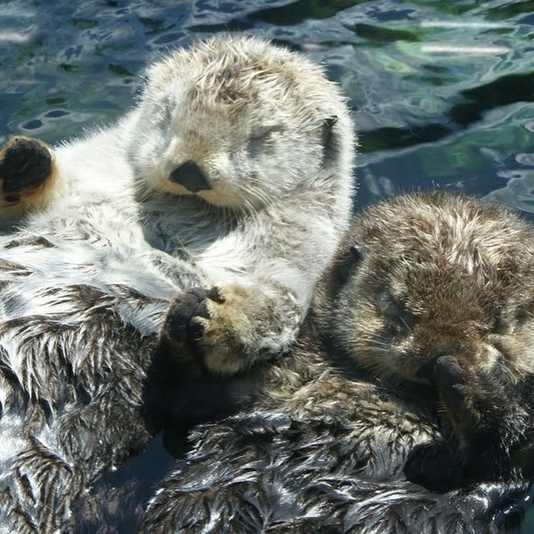
Sea otters sometimes hold hands while sleeping.

Slide 45
Otters are wild animals that require strict protection. In Vietnam, all otter species are listed in the Red Book and are classified as endangered and rare, requiring priority protection, and all acts of illegal hunting, trading, or keeping them in captivity are strictly prohibited.

Slide 46
Thanks for listening!

Slide 47
Thank you Ms.Mona Grace and Mr.Lữ Hồng Hải teaching me!
Thank you all my friend beacause you’re next to me and make me feel happy^^
Thank you Class 4B2 beacause you giveing me a lots off knowledge <( ^ v ^ )>
And thank you everyone 1 more time<3

Slide 48
Thank you Ms.Mona Grace and Mr.Lu Hong Hai for teaching me!
Thank you all my friends because you’re beside me and make me feel happy.^^
Thank you Class 4B2 because you give me a lot of knowledge.
<( ^ v ^ )>
And thank you everyone one more time<3

